Slide 1
Lechuguilla Cave
NSS Slide Program S753
Accompany Dave and Djuna as they tour spectacular Lechuguilla Cave through professional slides from their extensive award-winning collection.
By Dave Bunnell & Djuna Bewley, 1995
80 slides
Slides digitized by Dave Caudle ~2018
PowerPoint produced by David Socky January 2021

Slide 2
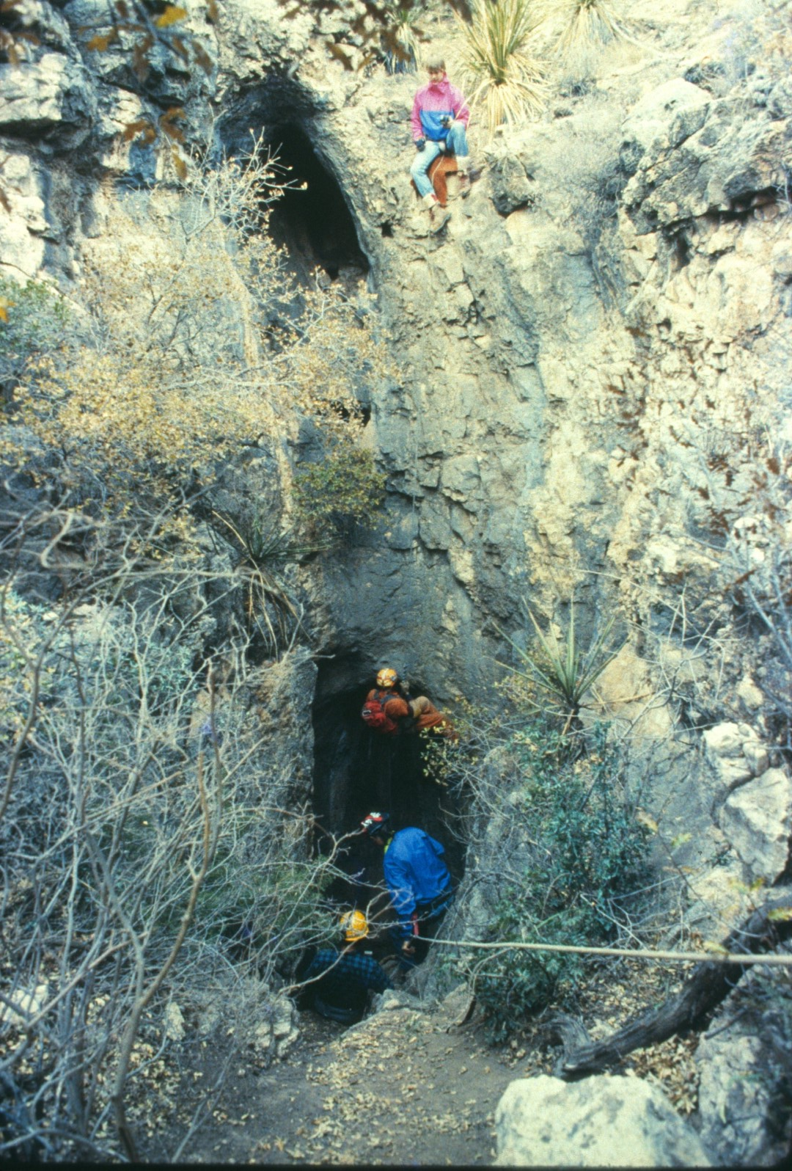
Notes:
The 80' entrance drop to Lechuguilla and the room below had been known since the early 1900s, and were mined for guano.

Slide 3
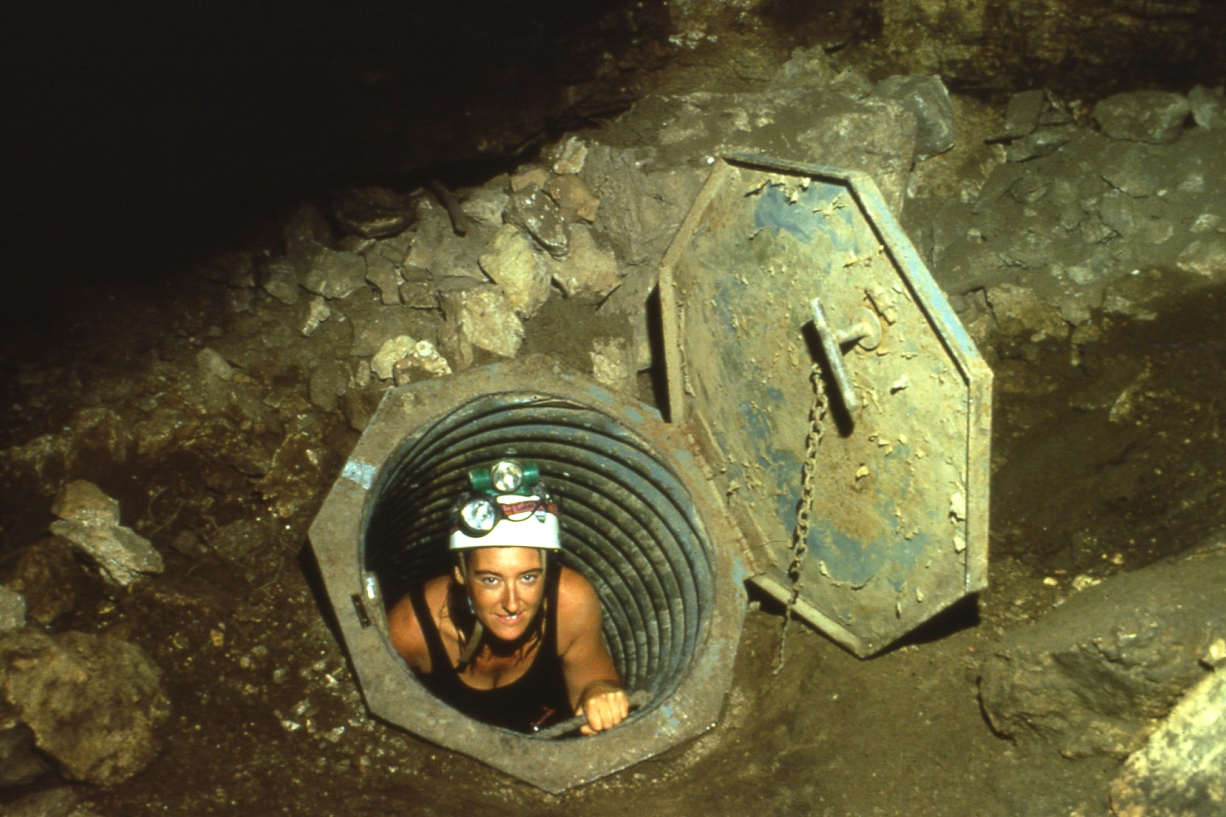
Notes:
A series of digs by Colorado cavers broke through in 1986. Entrance is now through this culvert, where 60 mph winds have been recorded.

Slide 4
Notes:
Deep secrets, in the Western Branch, was the first arm of the cave explored . These planar coralloids mark the entrance to Deep Sea camp.

Slide 5
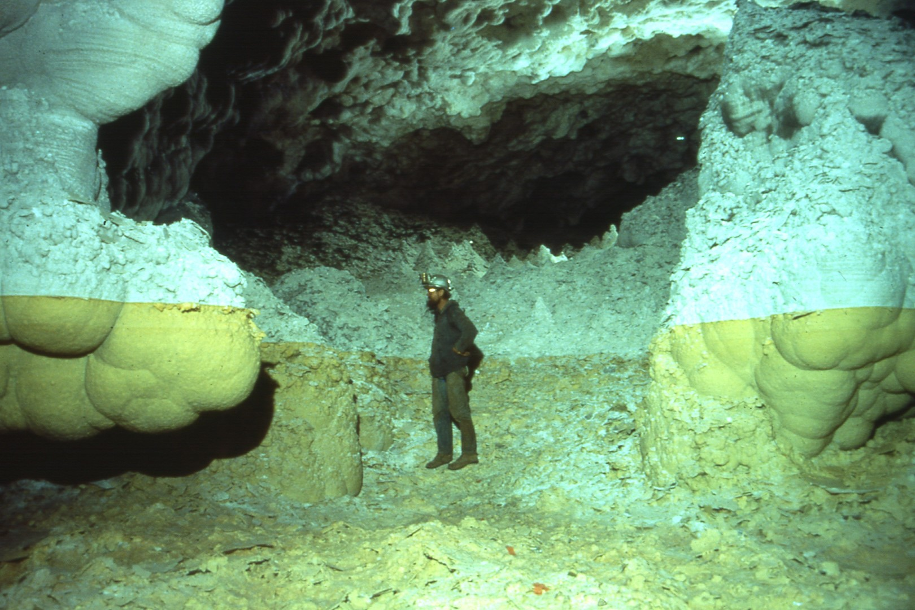
Notes:
Mammalaries or cave clouds are found in many parts of the cave, in old pool basins. These orange ones are above Lake Louise.

Slide 6
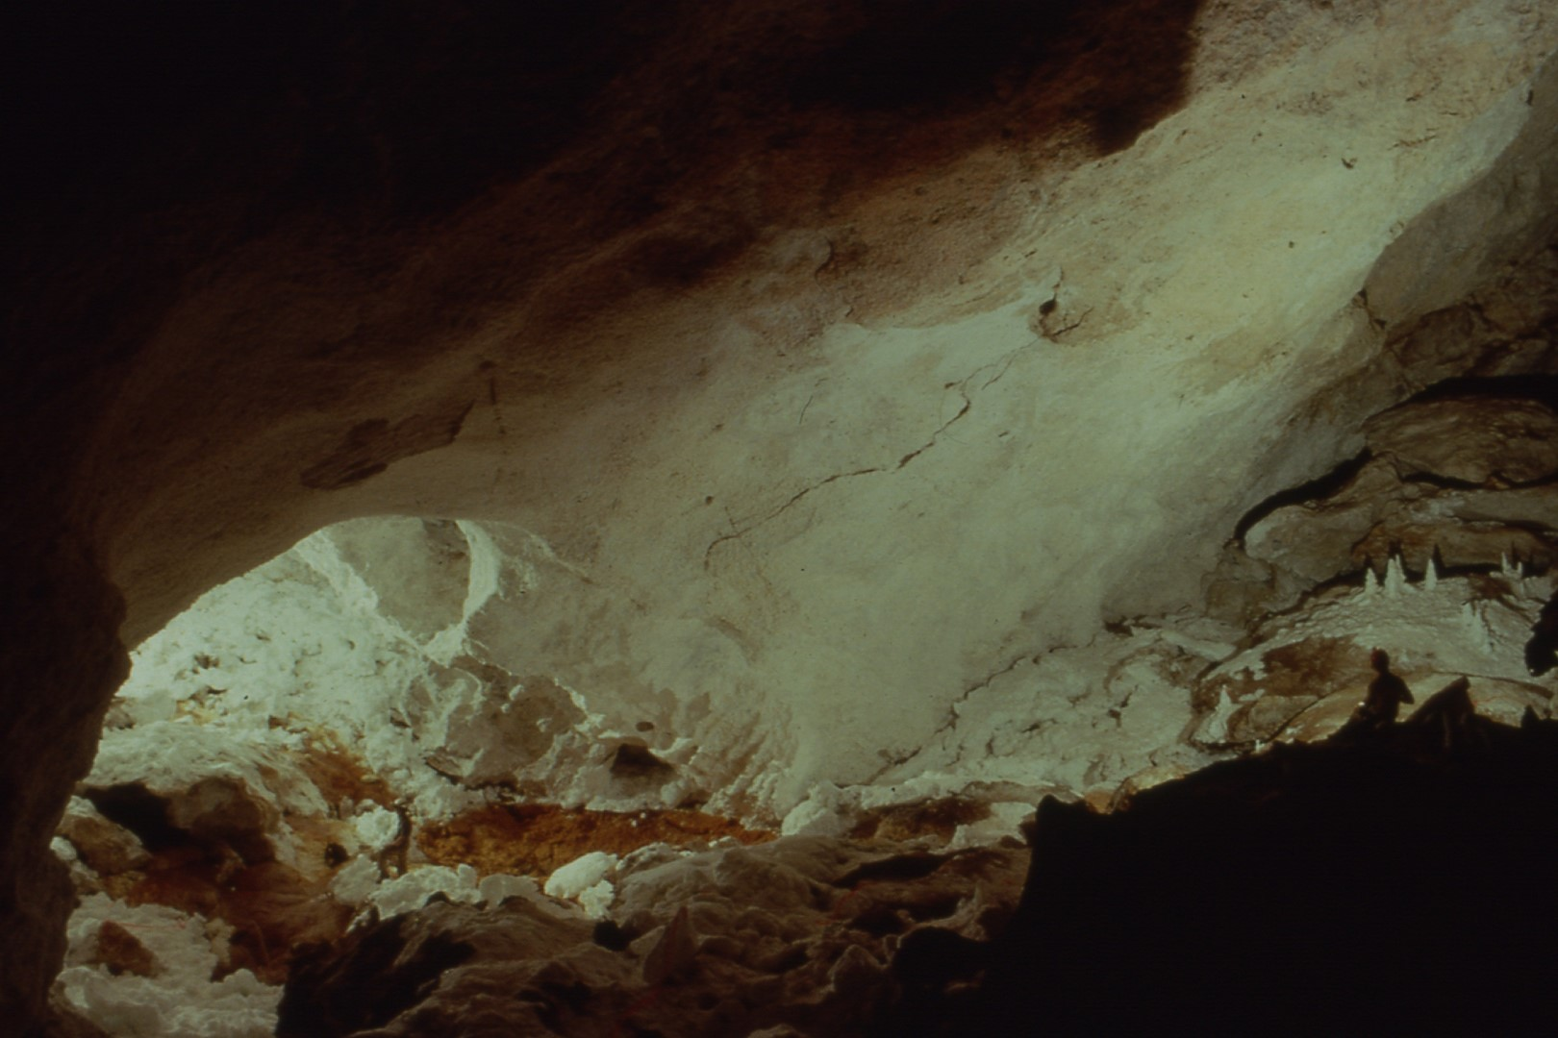
Notes:
The ABCS Room marks the start of the Western Borehole, the largest, most continuous passage in the cave. It extends over a mile.

Slide 7
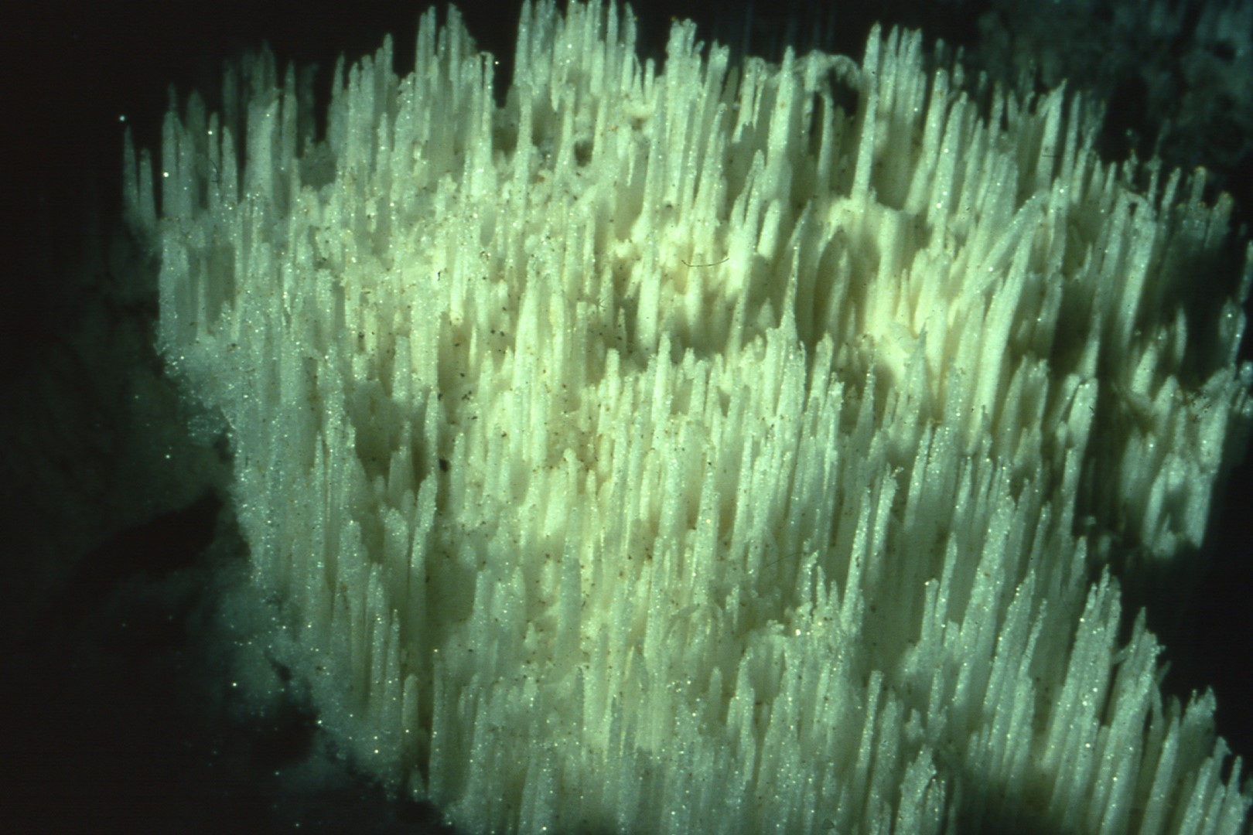
Notes:
Gypsum floors much of the Western Borehole and "drilled" formati6ns such as these are found along the trail. Note the tiny shield rock on each.

Slide 8
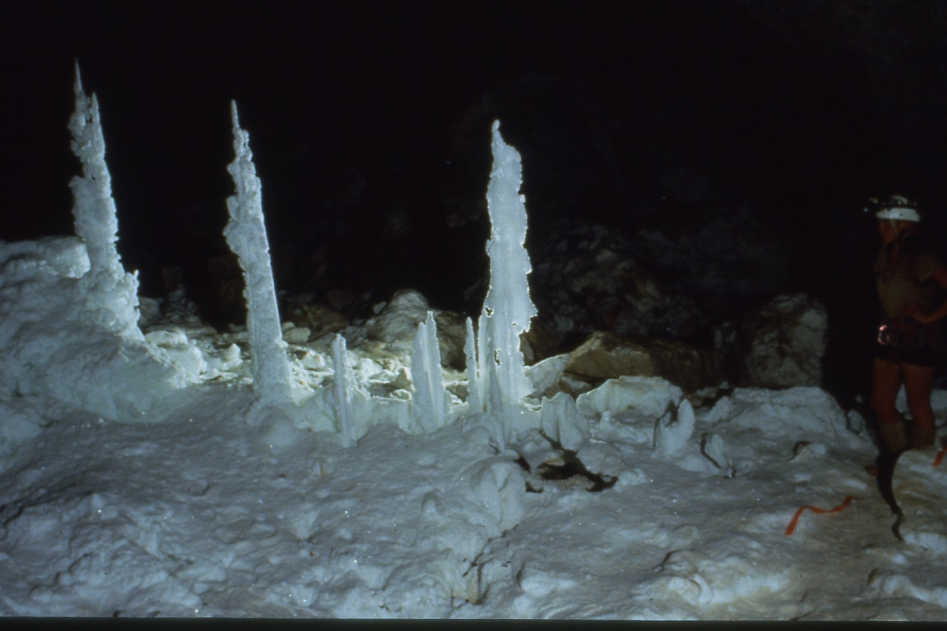
Notes:
The Three Amigos are probably the largest gypsum "drill" formations in the Western Borehole.

Slide 9
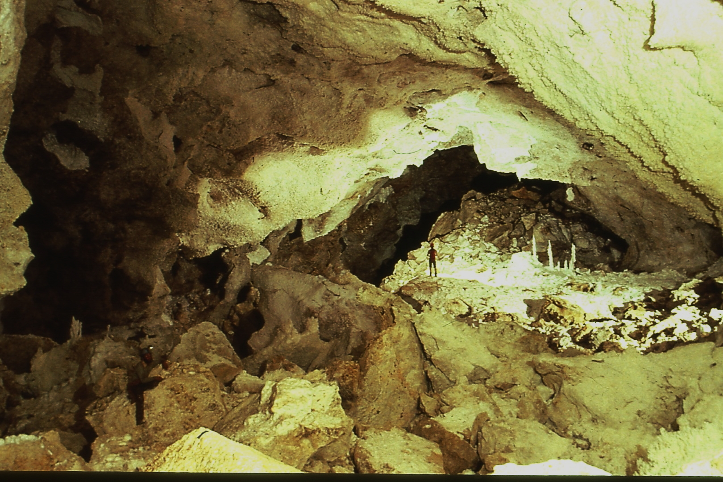
Notes:
Passage shot about halfway down the borehole. Note the Three Amigos in the distance.

Slide 10
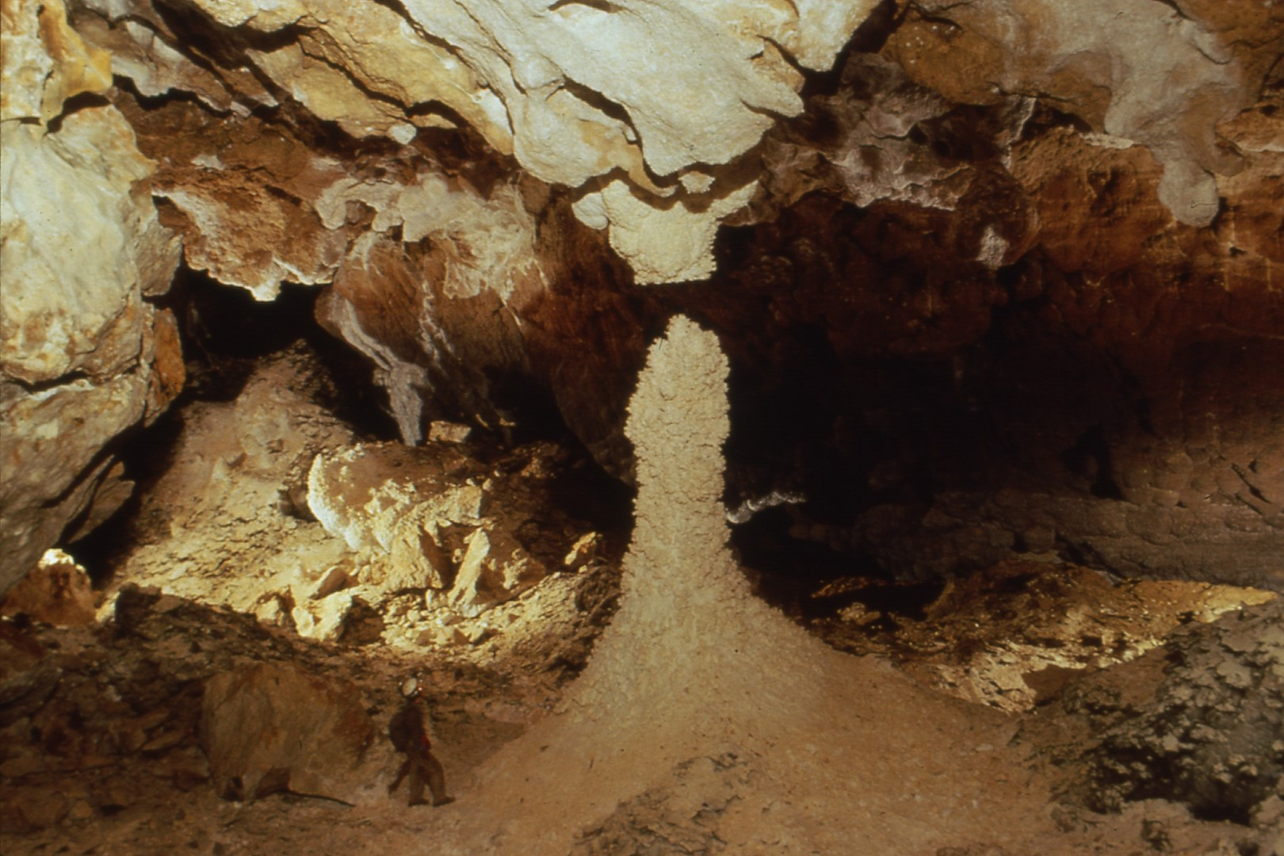
Notes:
The "Leaning Tower" is a raft cone covered with aragonite - perhaps the largest in the cave. It's found in an old pool basin.

Slide 11
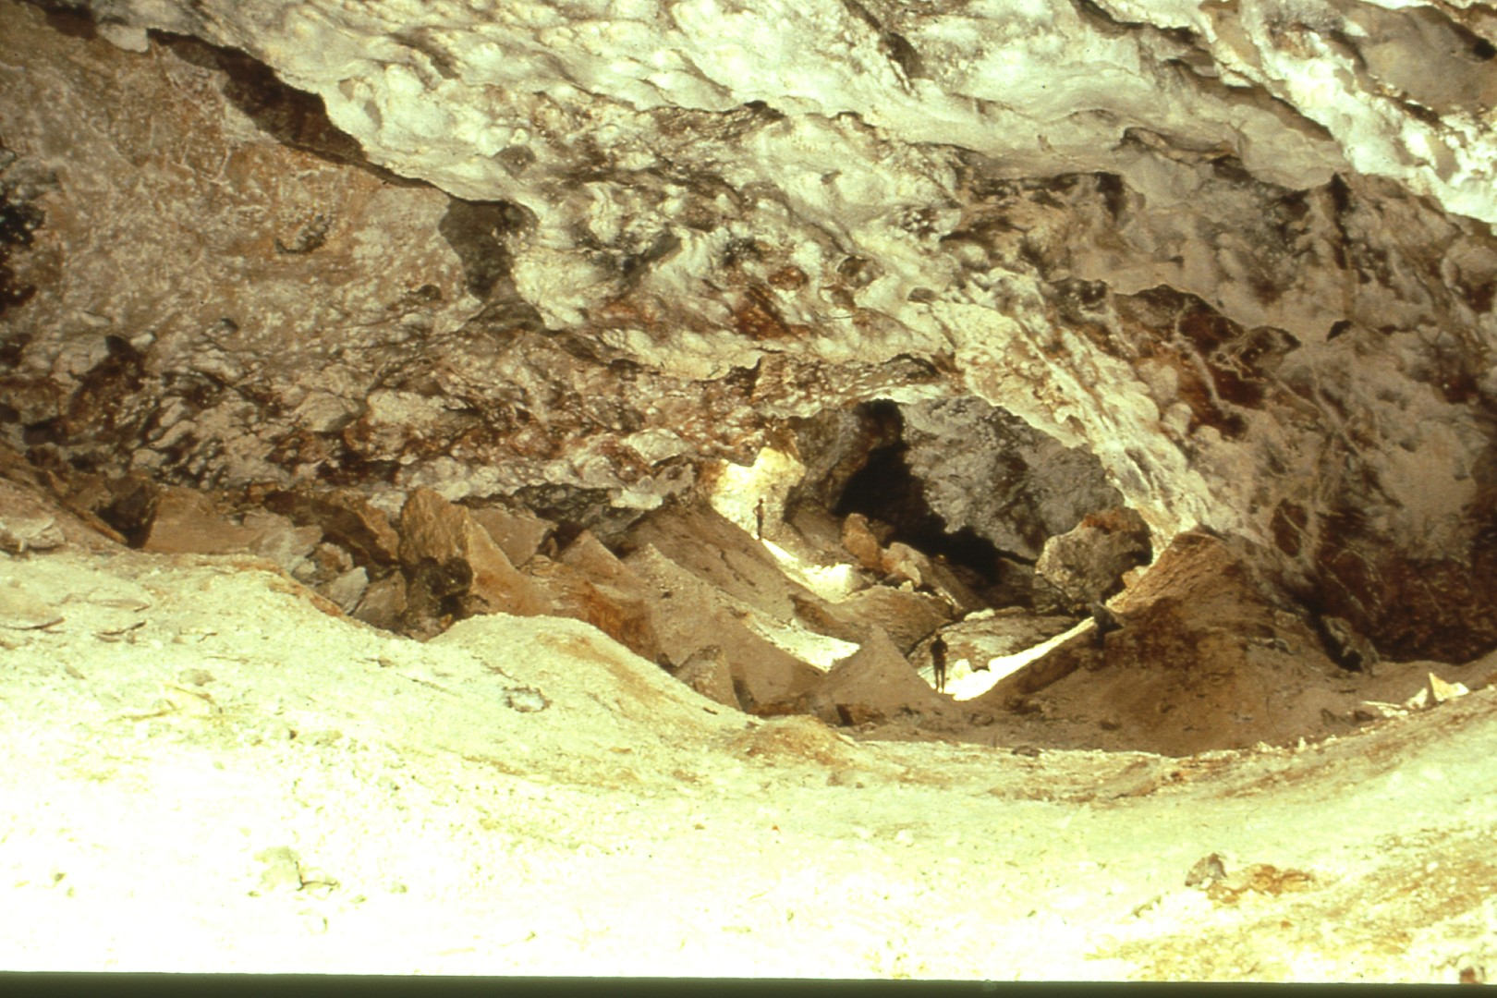
Notes:
"Raft Cone Land" is a portion of the Western Borehole floored entirely with layers of calcite rafts and numerous raft cones.

Slide 12
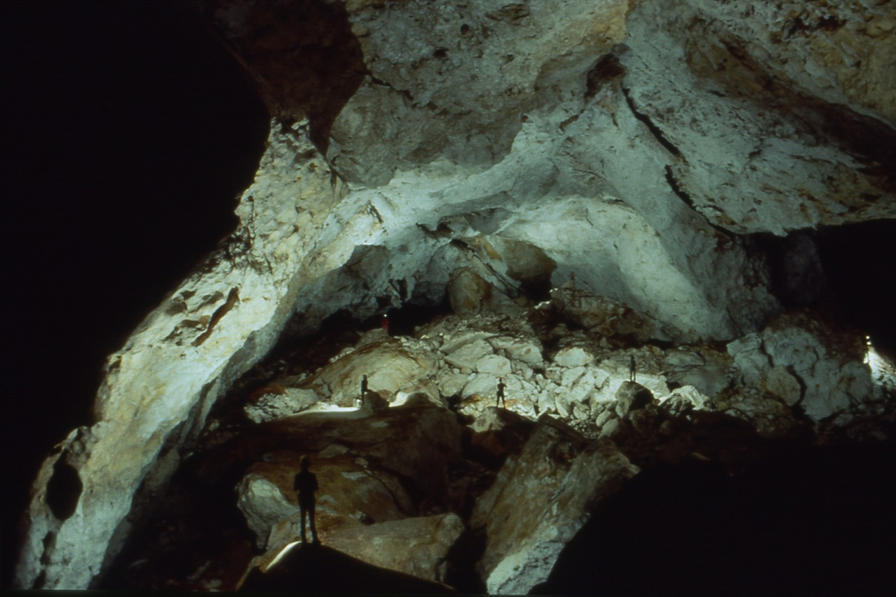
Notes:
The Huapache Highway is one of the largest passages in the cave, just beyond Hard Daze Night Hall, a huge chamber.

Slide 13
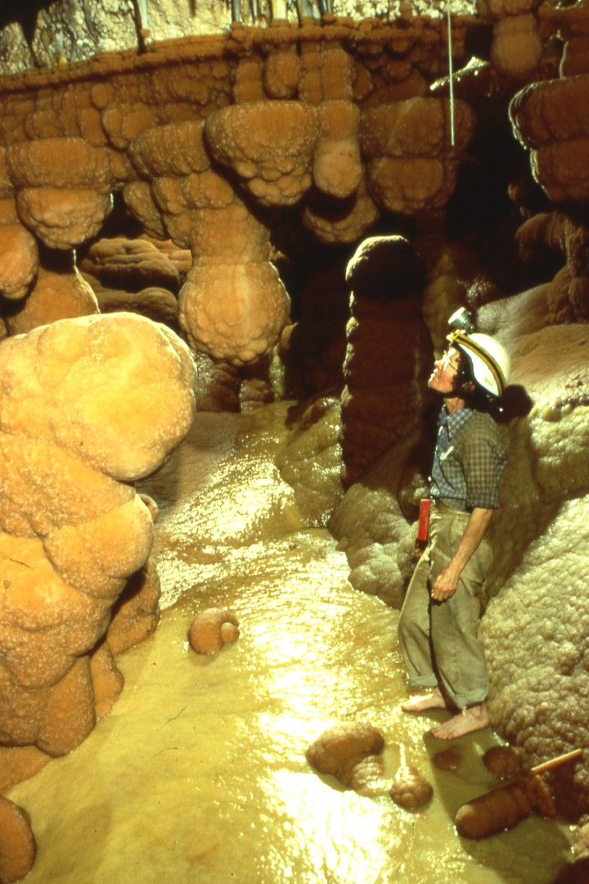
Notes:
After a mile of bone-dry passage, an active area is reached at the end of the Western Borehole: the Oasis, a receding pool basin.

Slide 14
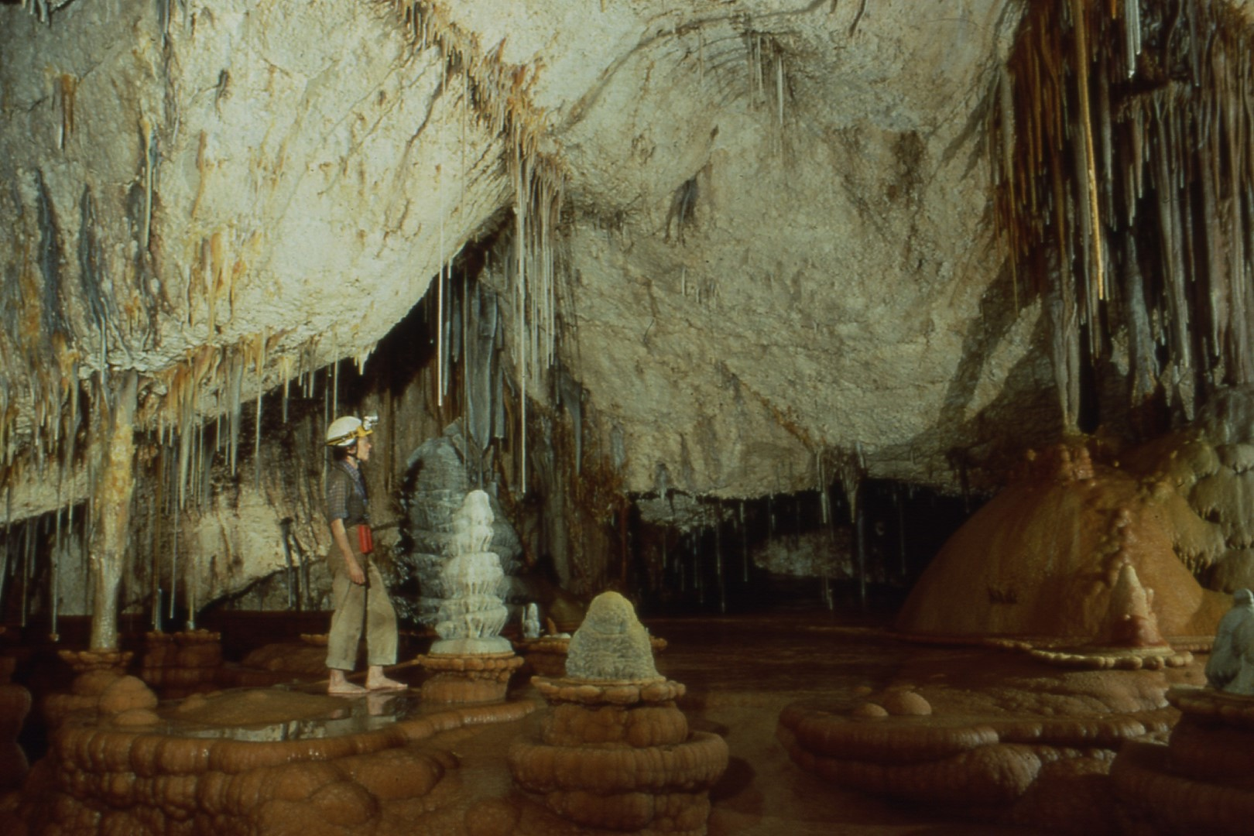
Notes:
Inside the Oasis Pool Room, near the top of the water line.

Slide 15
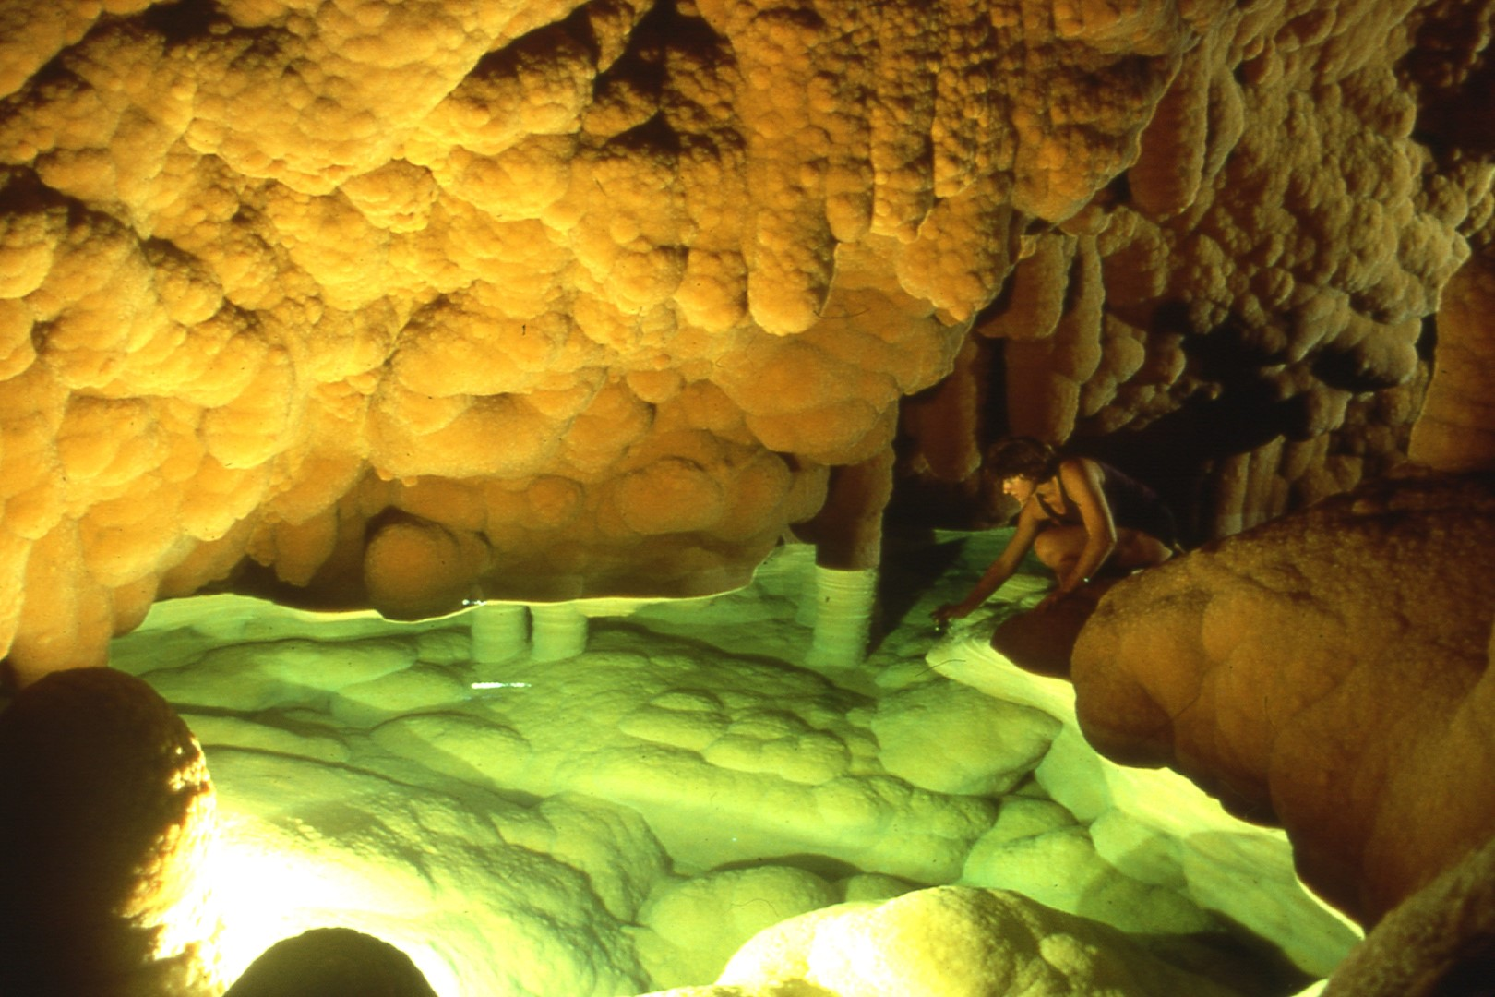
Notes:
Little is left of the pool which once filled the Oasis Chamber, but it’s a welcome source of water for thirsty caver. Note orange mammillary crusts.

Slide 16
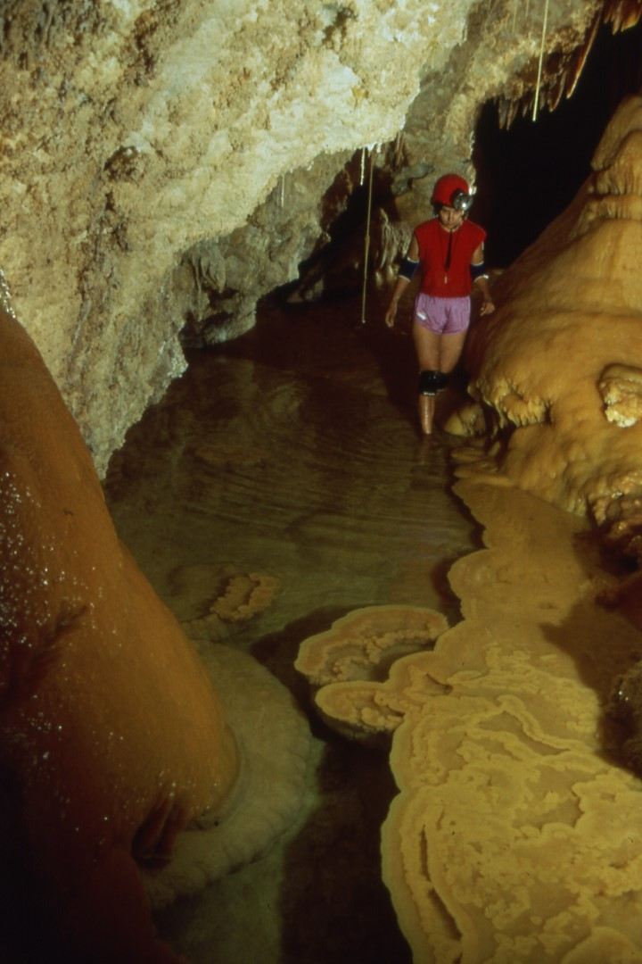
Notes:
The Red Lake Passage is in the same vicinity as the Oasis. Note the 5' long soda straw which extends directly into the pool.

Slide 17
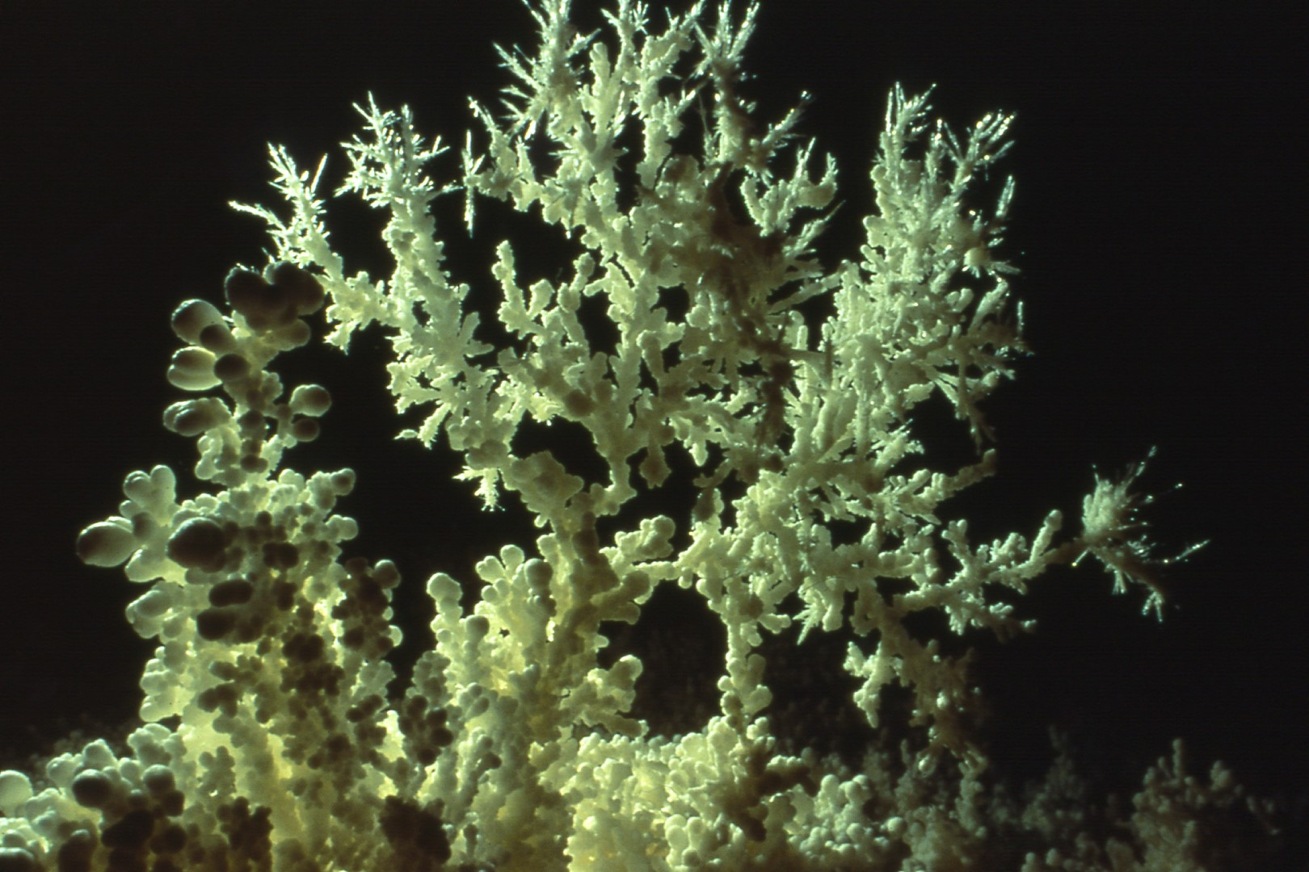
Notes:
South Winds, a complex of passage south of the Western Borehole, is noted for its impressive aragonite bushes.

Slide 18
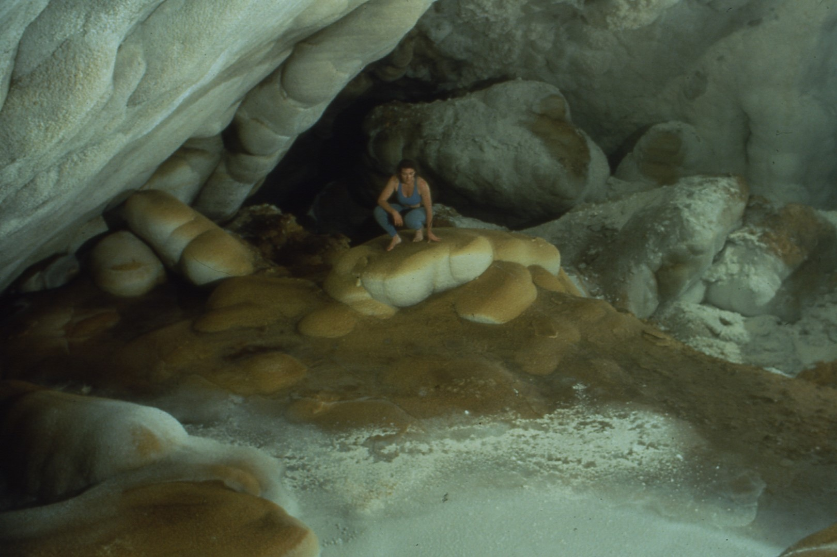
Notes:
The Northwest Passage leads from the Western Borehole to Hudson Bay. I call this area of the room the "Toasted Marshmallows".

Slide 19
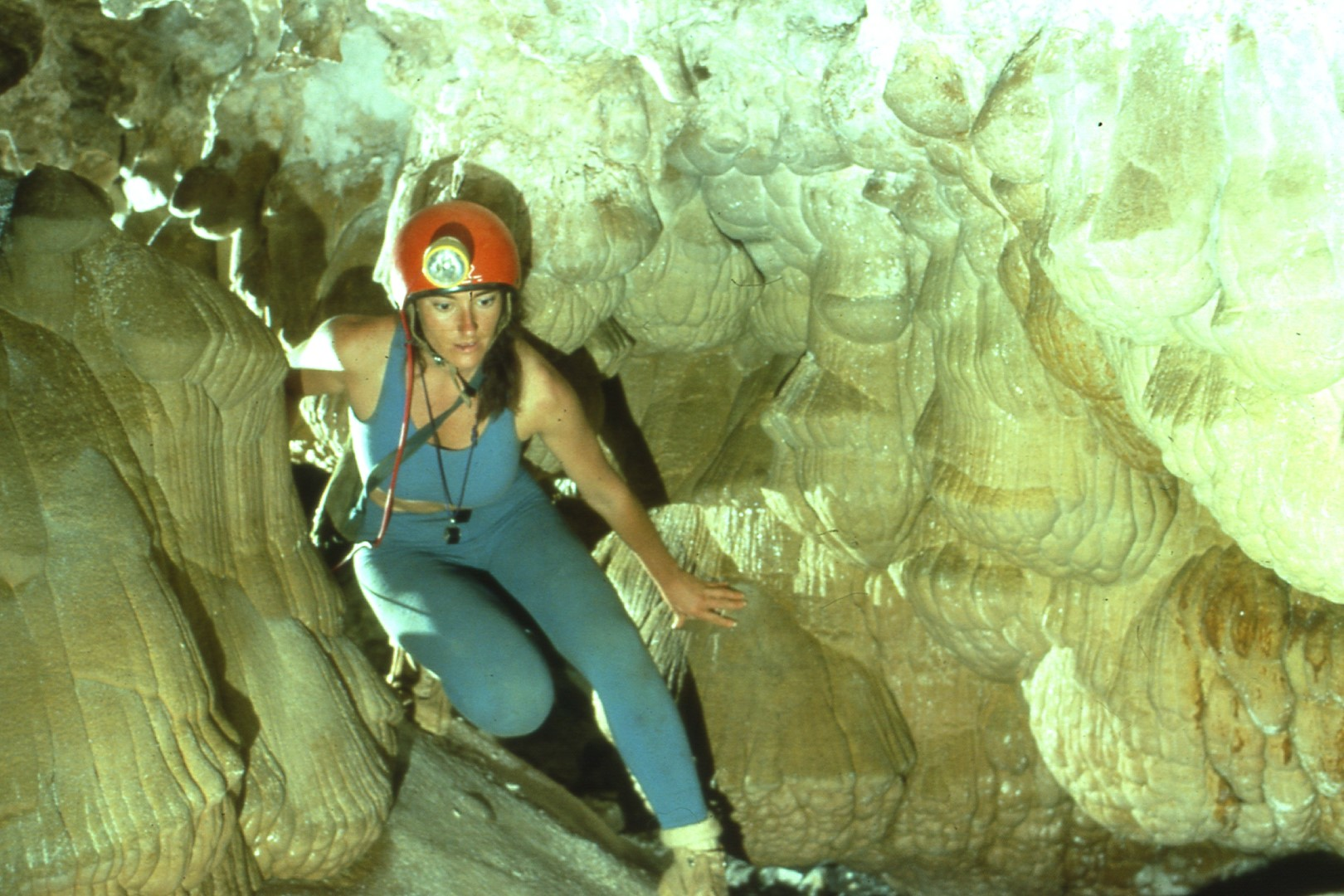
Notes:
These unusual mammillaries are found in the Northwest Passage.

Slide 20
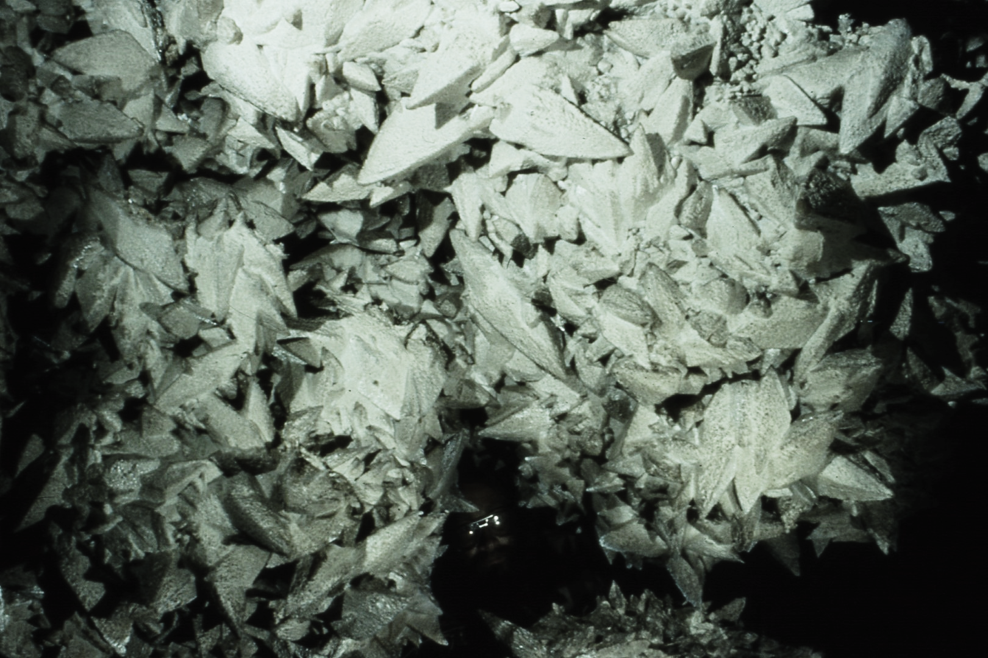
Notes:
Spar City is a portion of the Northwest Passage entirely covered with large spar crystals. Note the caver peering through the hole.

Slide 21
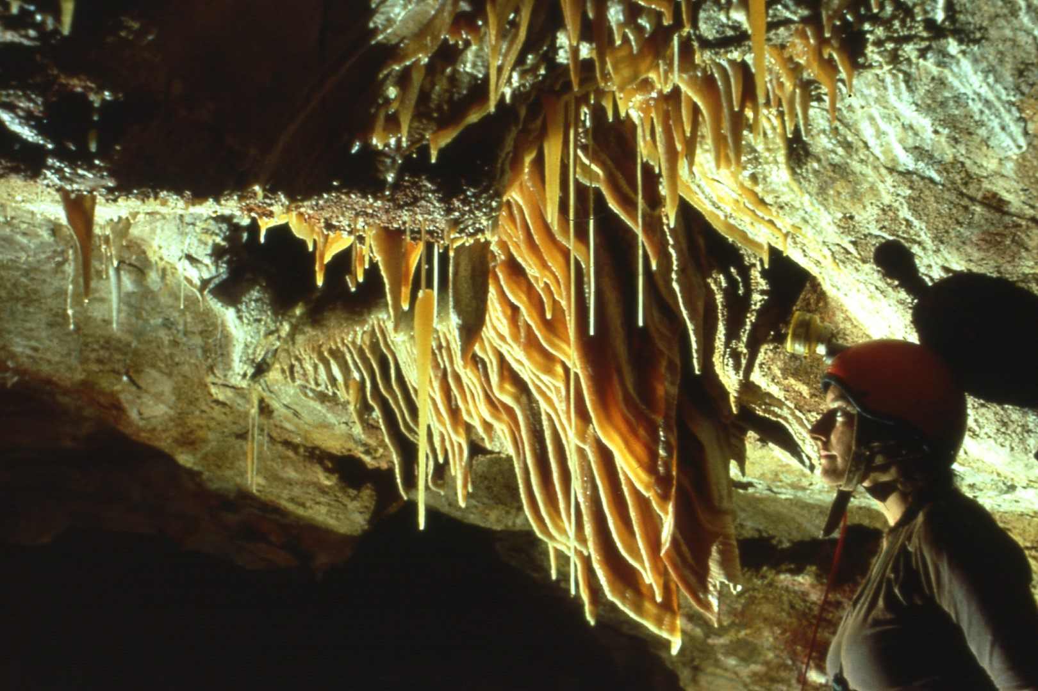
Notes:
Beyond Spar City, a series of ascents on flowstone led to the well decorated “There Be Dragons section”.

Slide 22
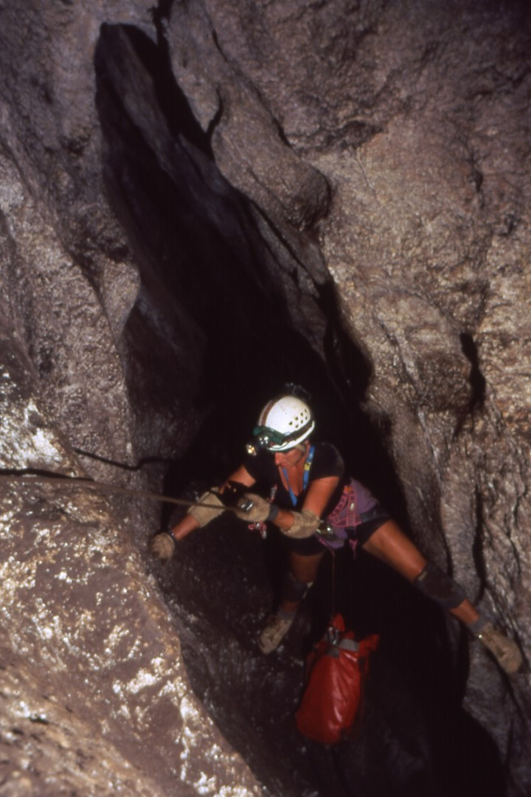
Notes:
The second arm of the cave discovered was accessed by Apricot Pit, over 300' of ropework down a sloping rift.

Slide 23
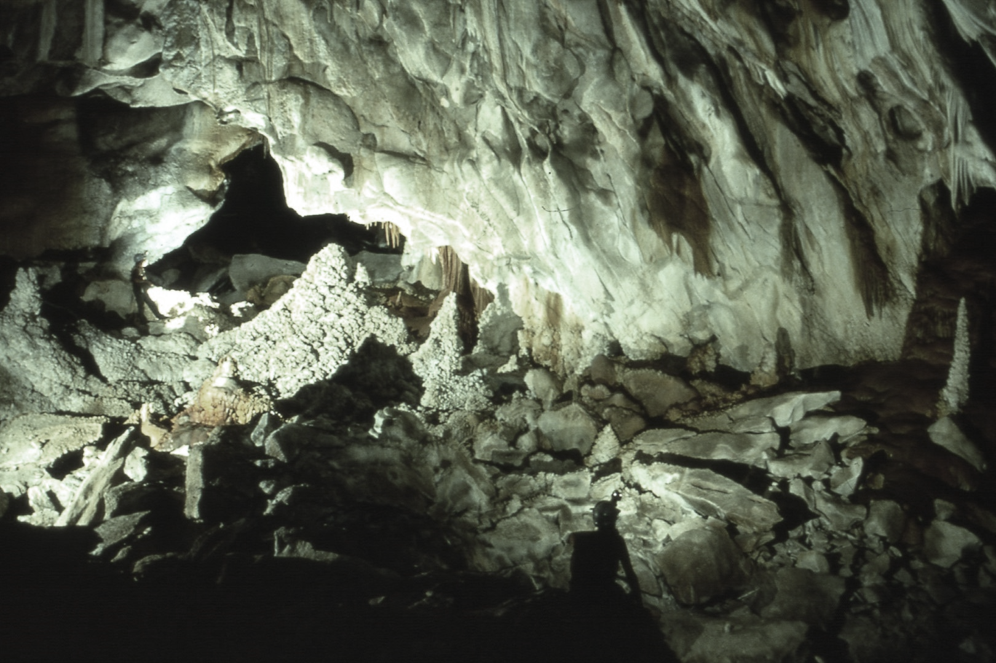
Notes:
Below the rift are a series of decorated chambers known collectively as Nirvana. This is the Emperor's Chamber.

Slide 24
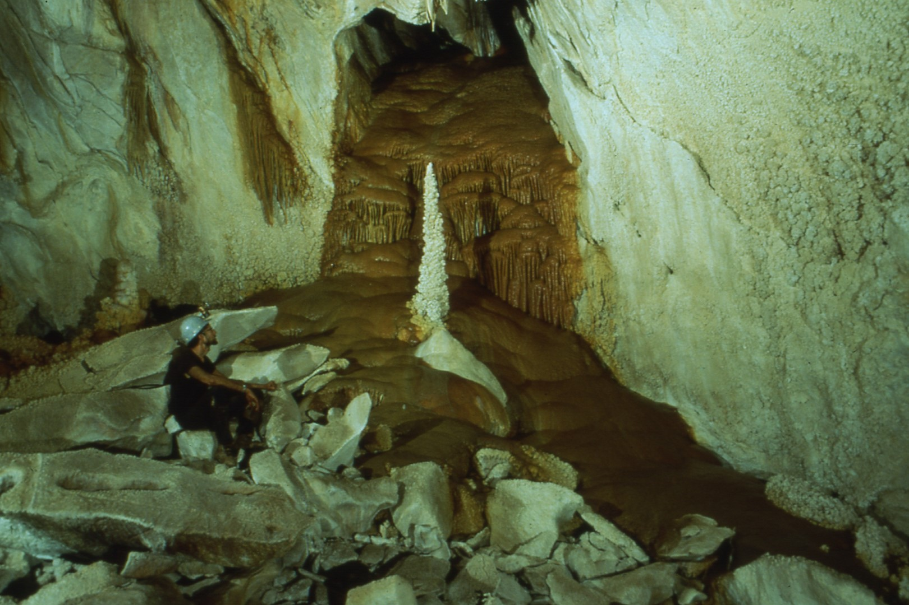
Notes:
The Emperor formation.

Slide 25
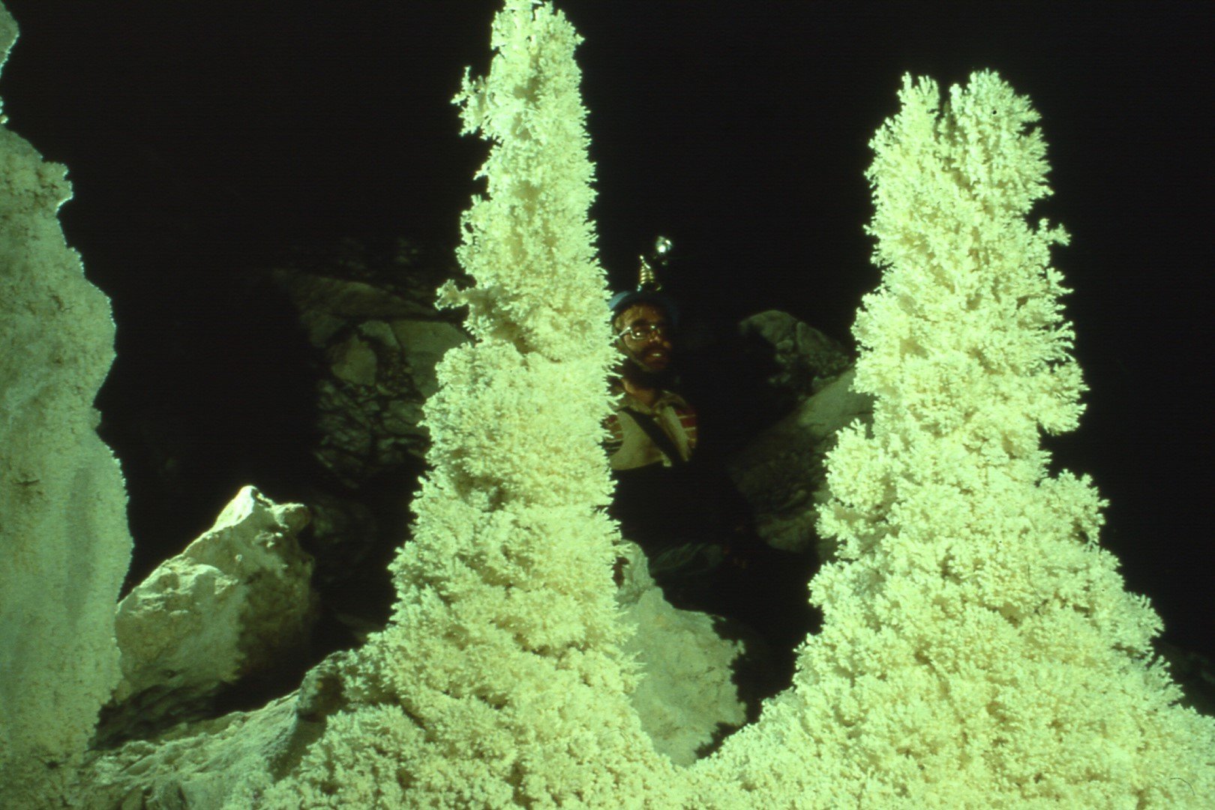
Notes:
Aragonite towers are strewn throughout the Great Beyond, a large chamber marking the end of Nirvana and beginning the Near East.

Slide 26
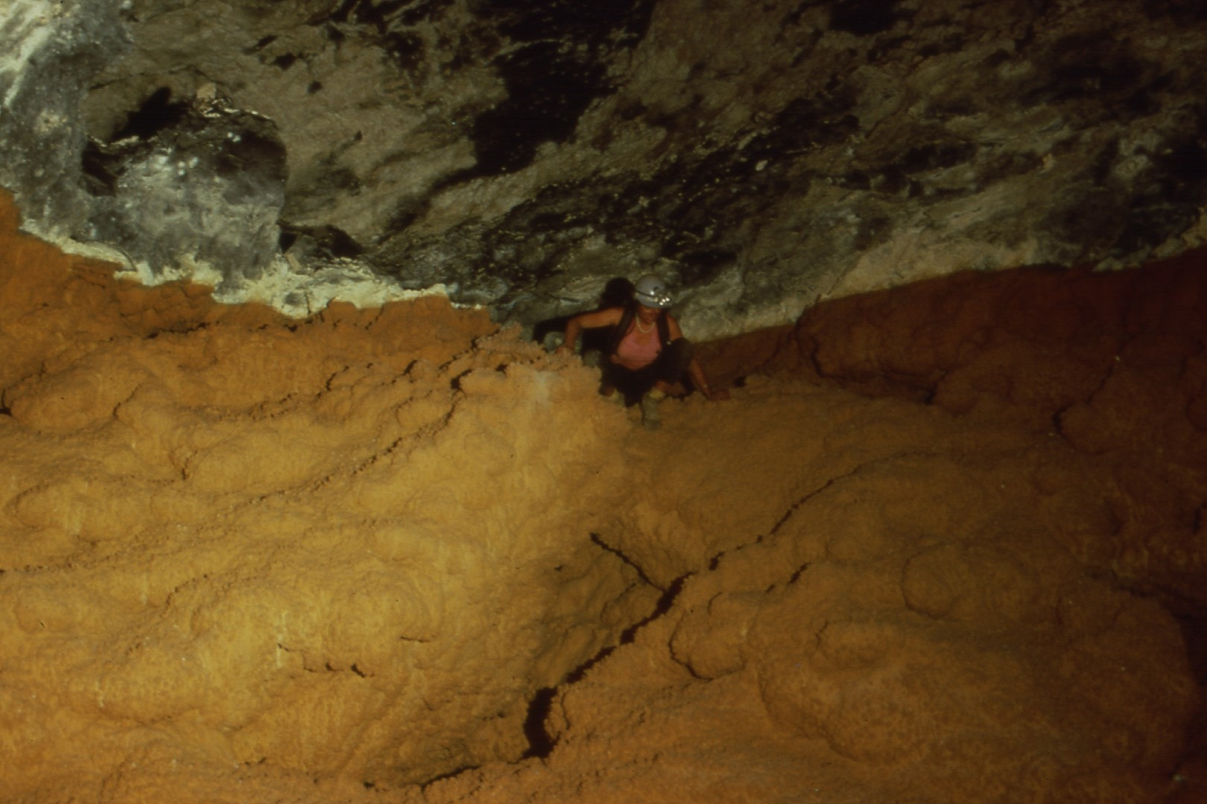
Notes:
The Orange Bowl is a dry pool basin.

Slide 27
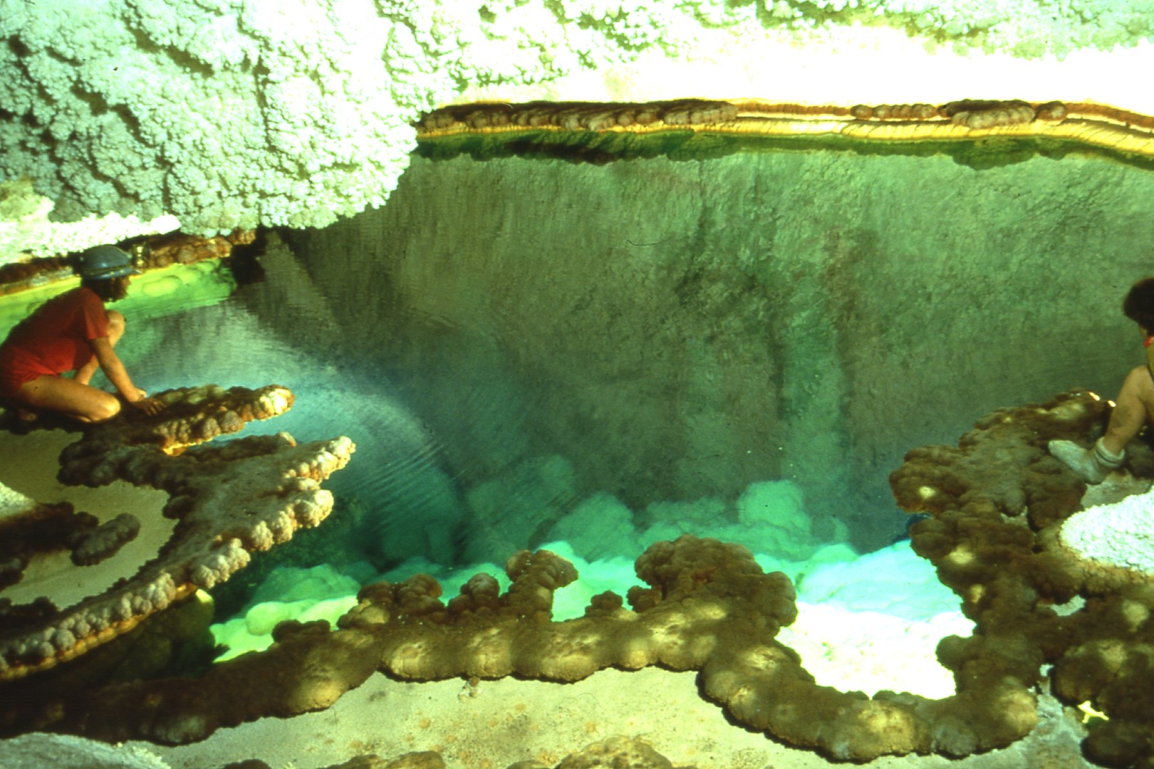
Notes:
Not all the lakes in Nirvana are dry. This is the Lake of the Blue Giants, named for its large submerged stalagmites, up to 12' tall.

Slide 28
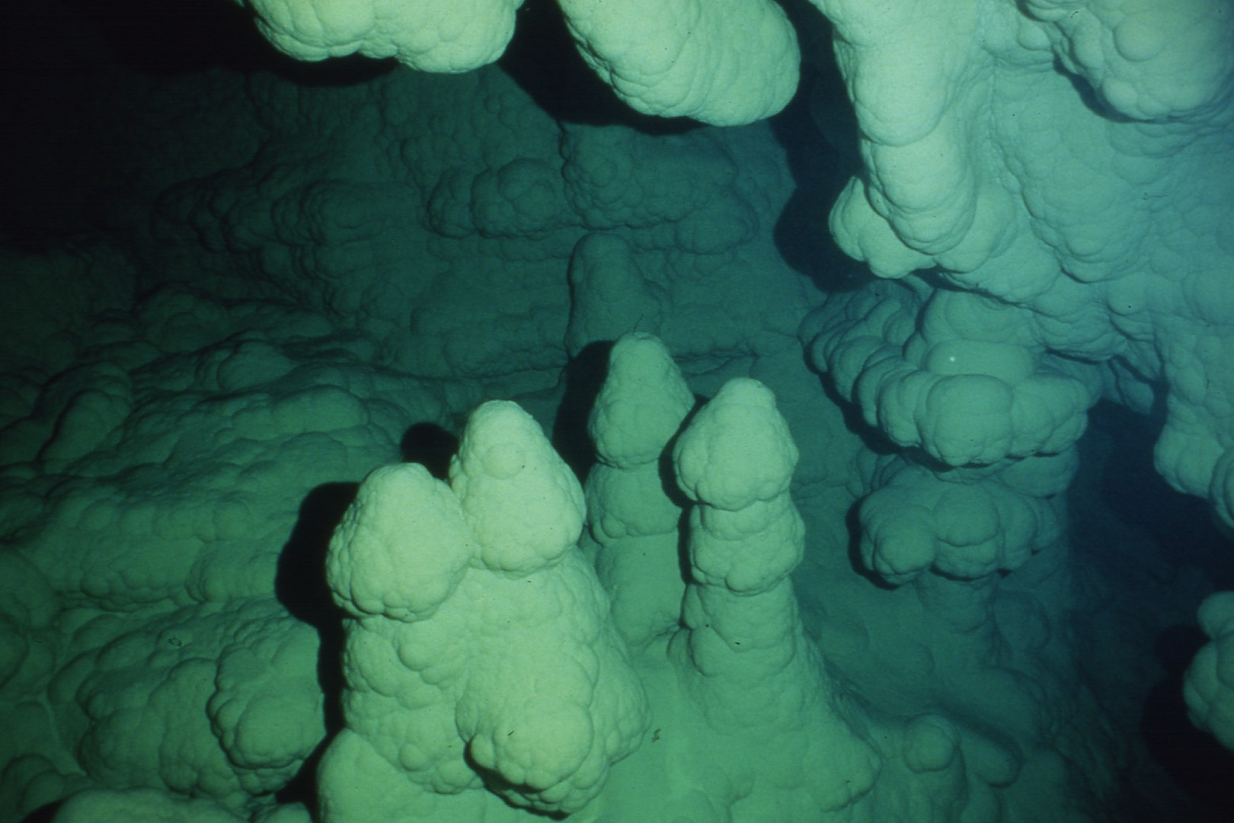
Notes:
Submerged stalagmites in Lake of the Blue Giants, shot at a depth of about 20'. Note the encrusted shelf-stone on the left, indicating former pool levels.

Slide 29
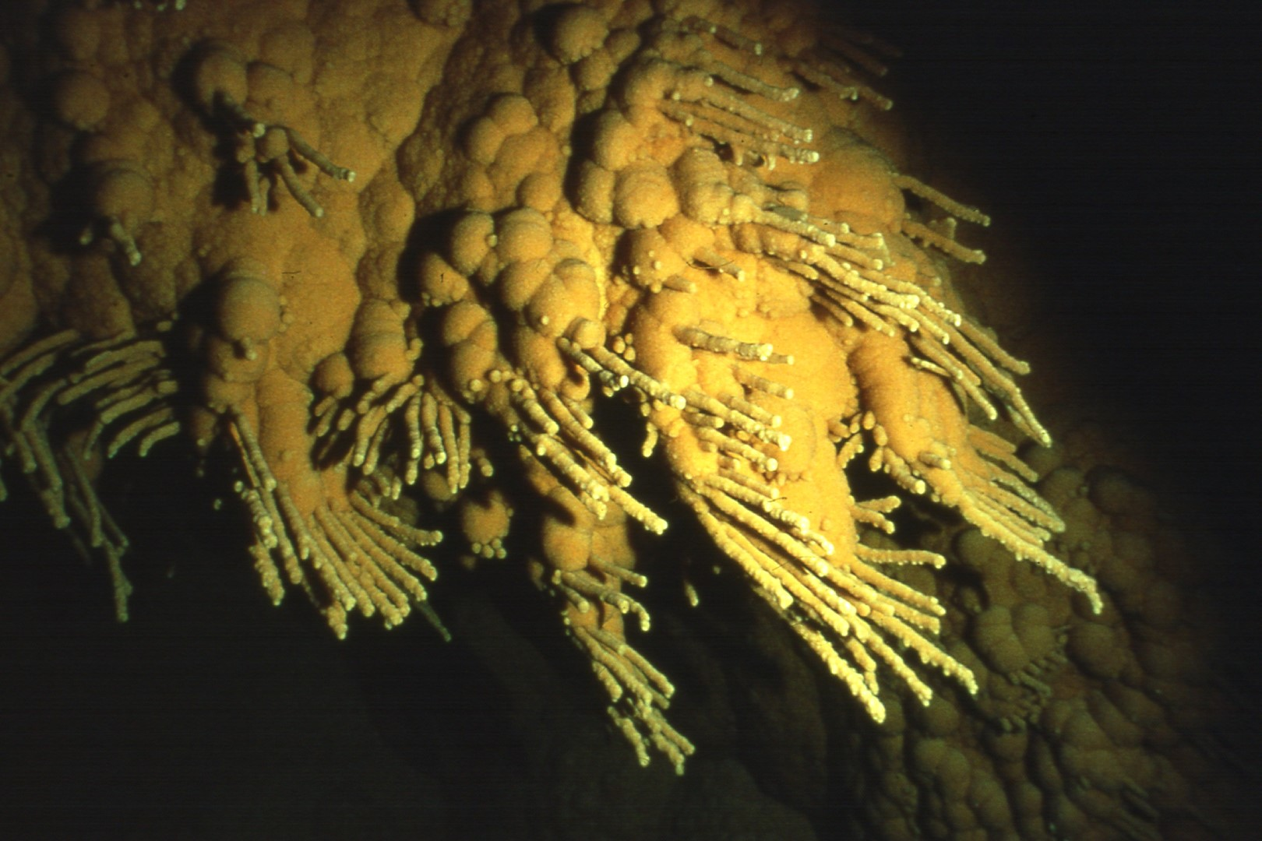
Notes:
Diving in nearby Stud Lake turned up these unique subaqueous helictites, about ten feet below the water's surface.

Slide 30
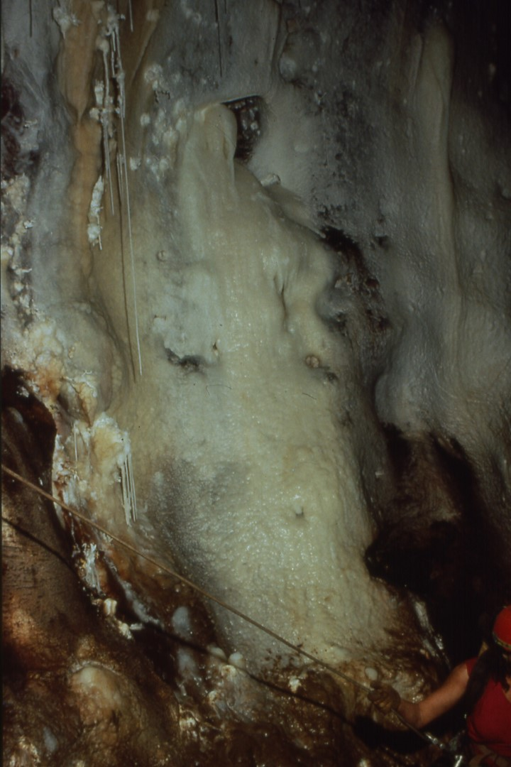
Notes:
After traveling through Nirvana and the Near East, a 200' ascent leads to the top of the Aragonitemare and the Far East.

Slide 31
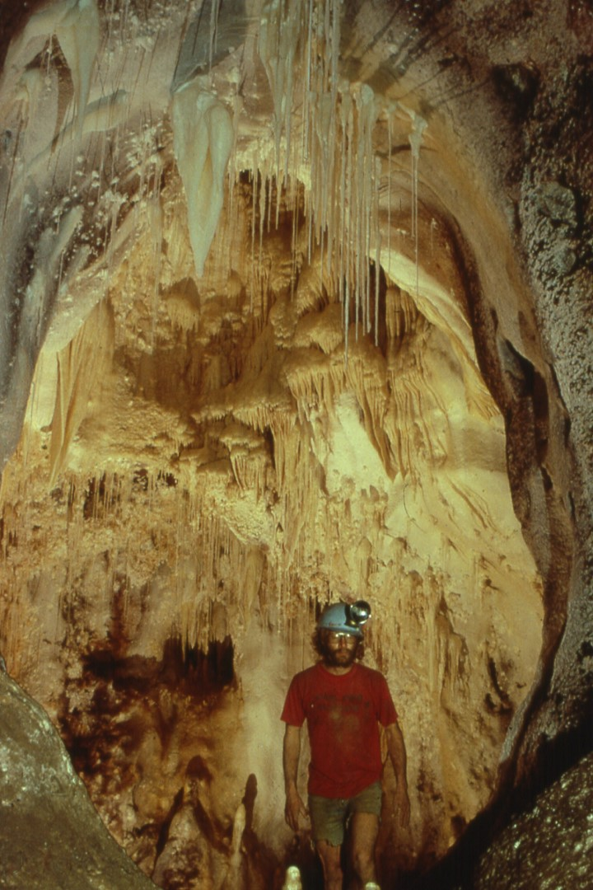
Notes:
The top of the Aragonitemare, like much of the Far East, is well decorated.

Slide 32
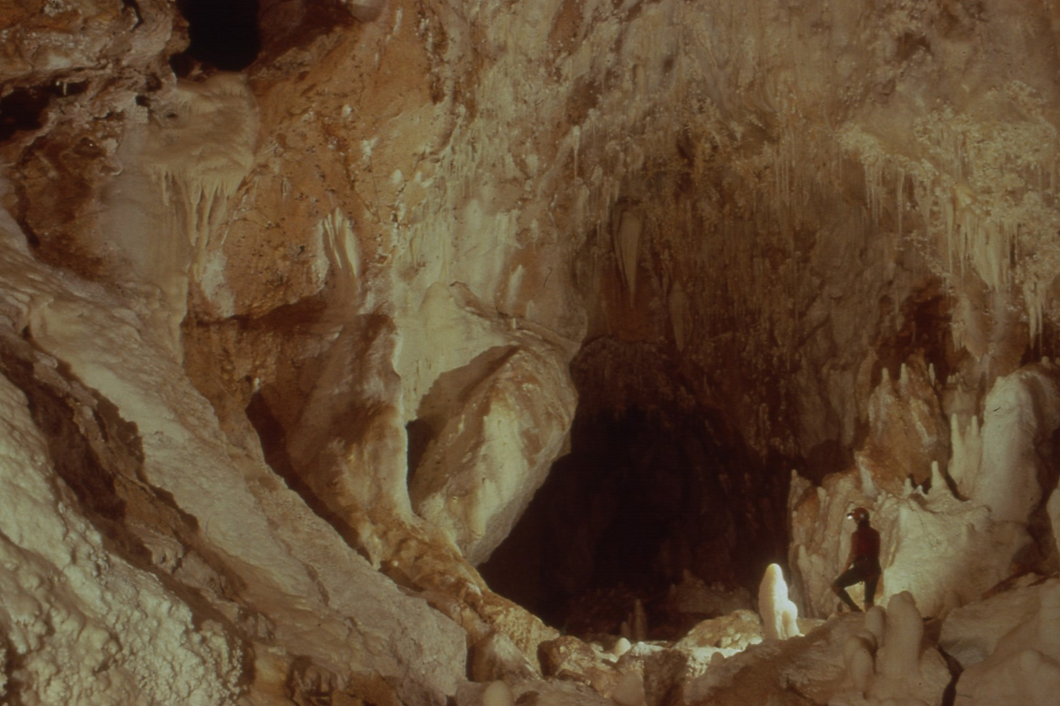
Notes:
A major chamber in the Far East is the Land of Fire and Ice.

Slide 33
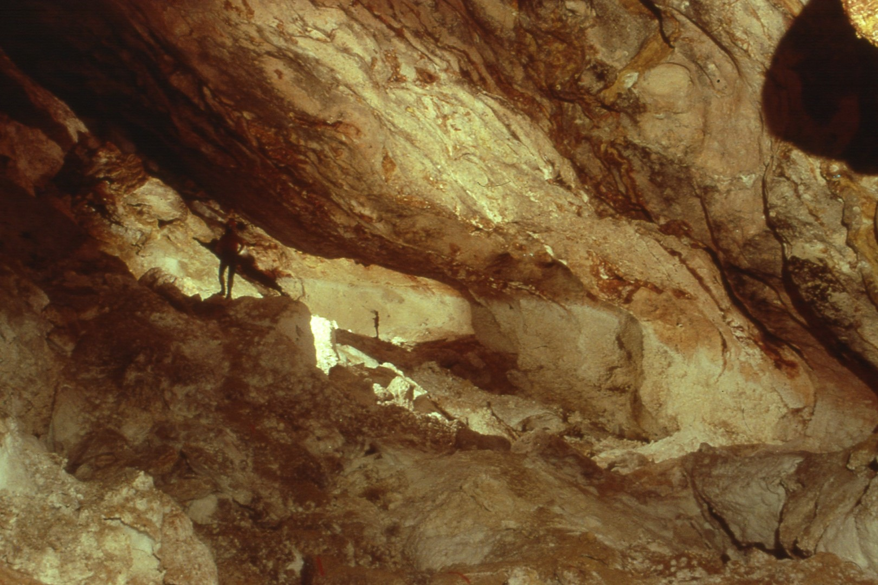
Notes:
Beyond Fire and Ice, a major trunk passage called Glacier Way leads to Grand Guadalupe camp.

Slide 34
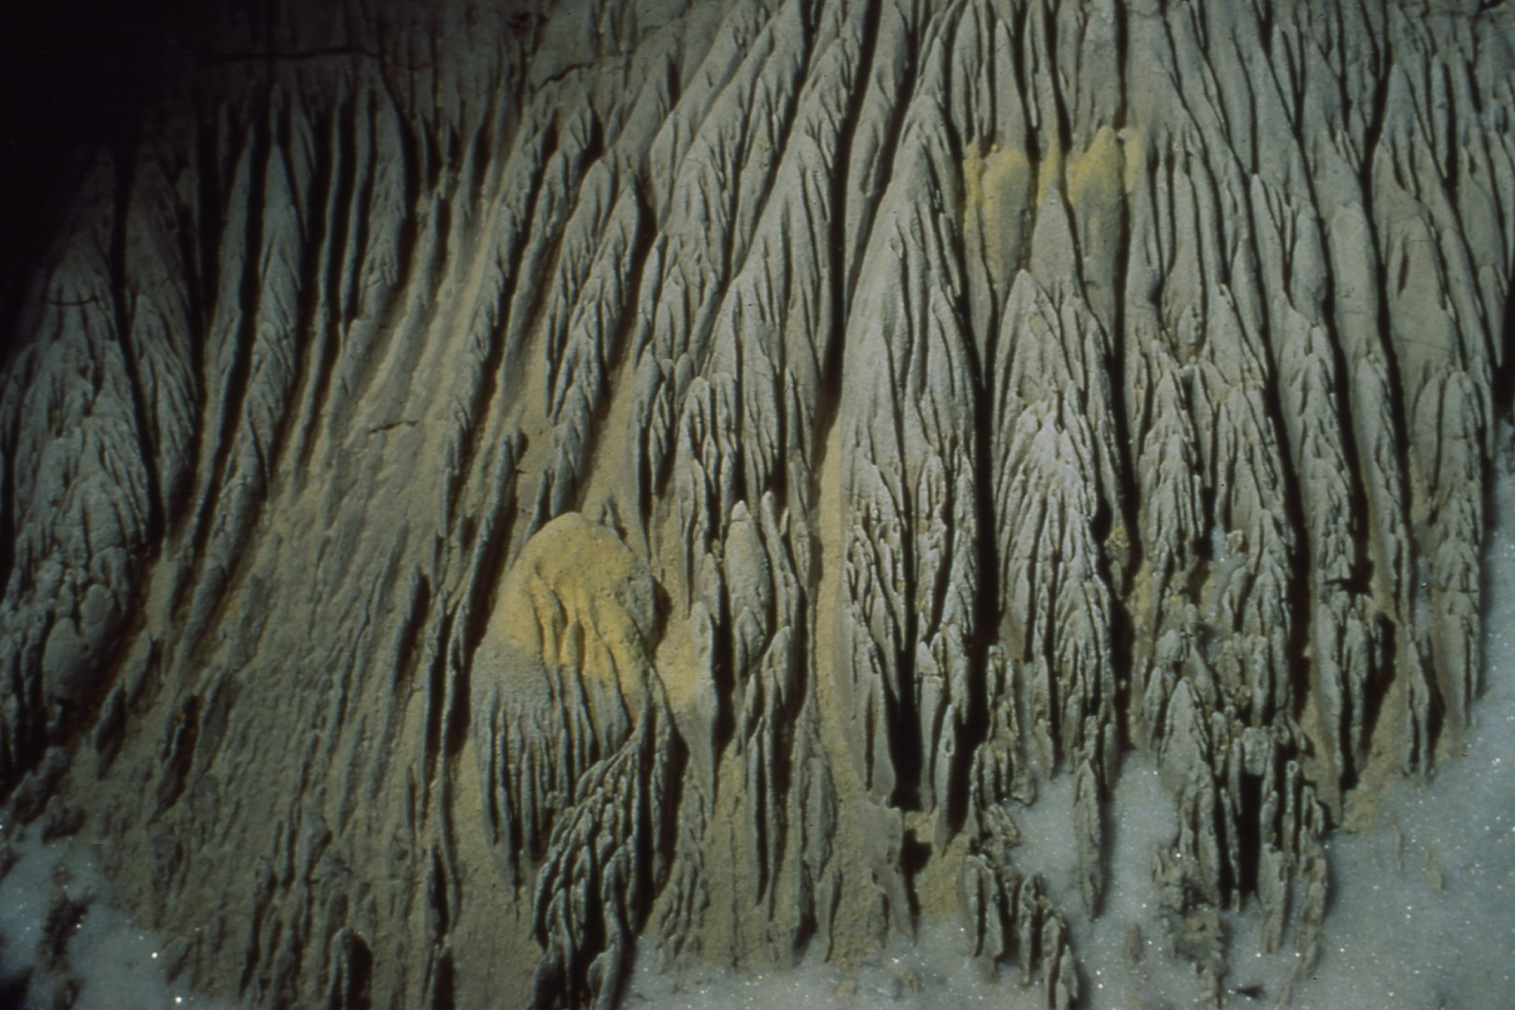
Notes:
A side passage off Glacier Way leads to Bryce Canyon, where acidic waters have carved impressive rillenkarren.

Slide 35
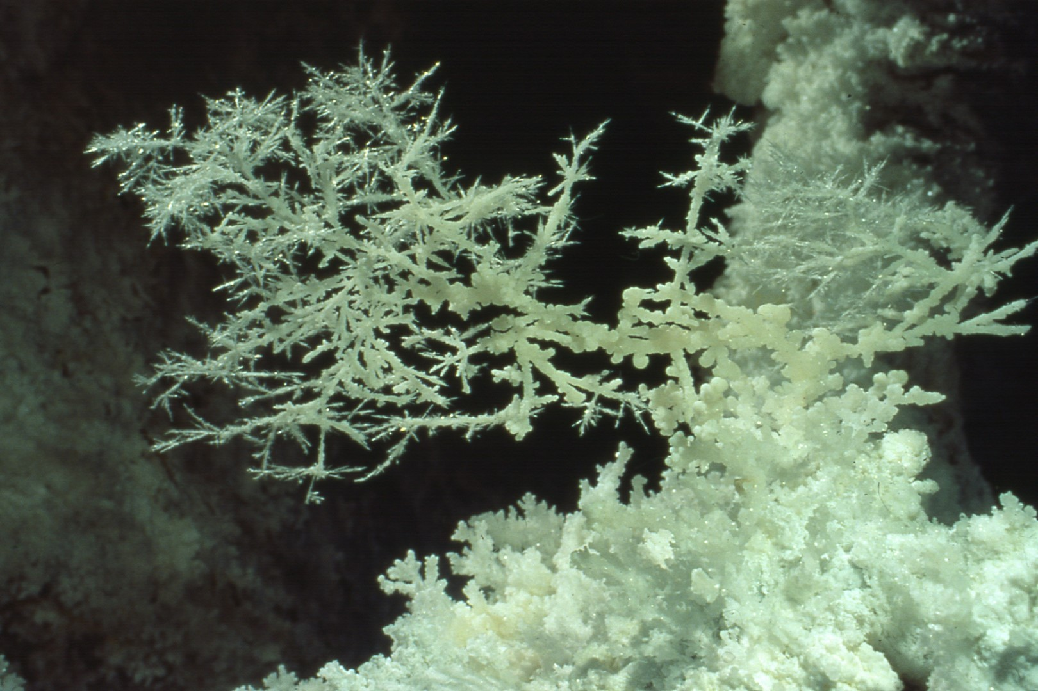
Notes:
One of the most impressive aragonite bushes is found in the Far East. The "plate" is remarkably two dimensional and almost 2' high.

Slide 36
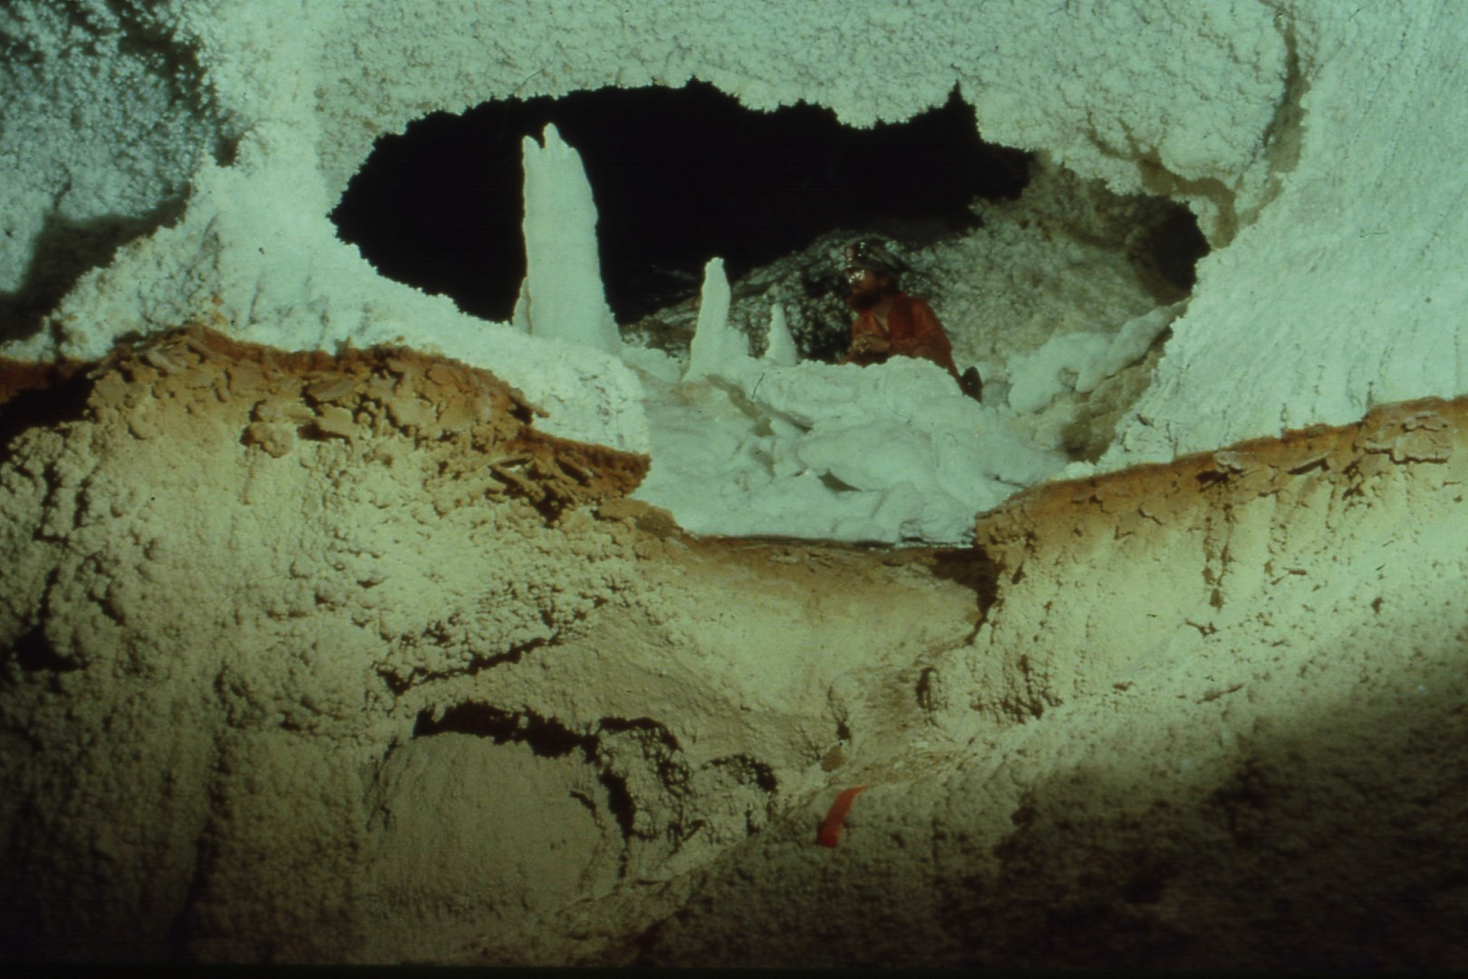
Notes:
Just beyond the Far East camp, a gypsum-lined passage leads into dry pool basins.

Slide 37
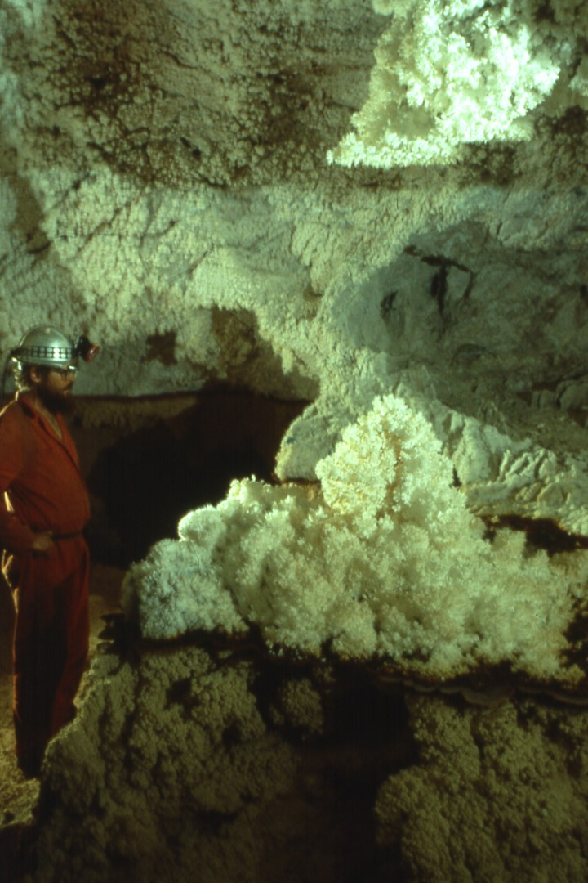
Notes:
Donald Davis admires aragonite bushes on red shelfstone in the dry pool basins.

Slide 38
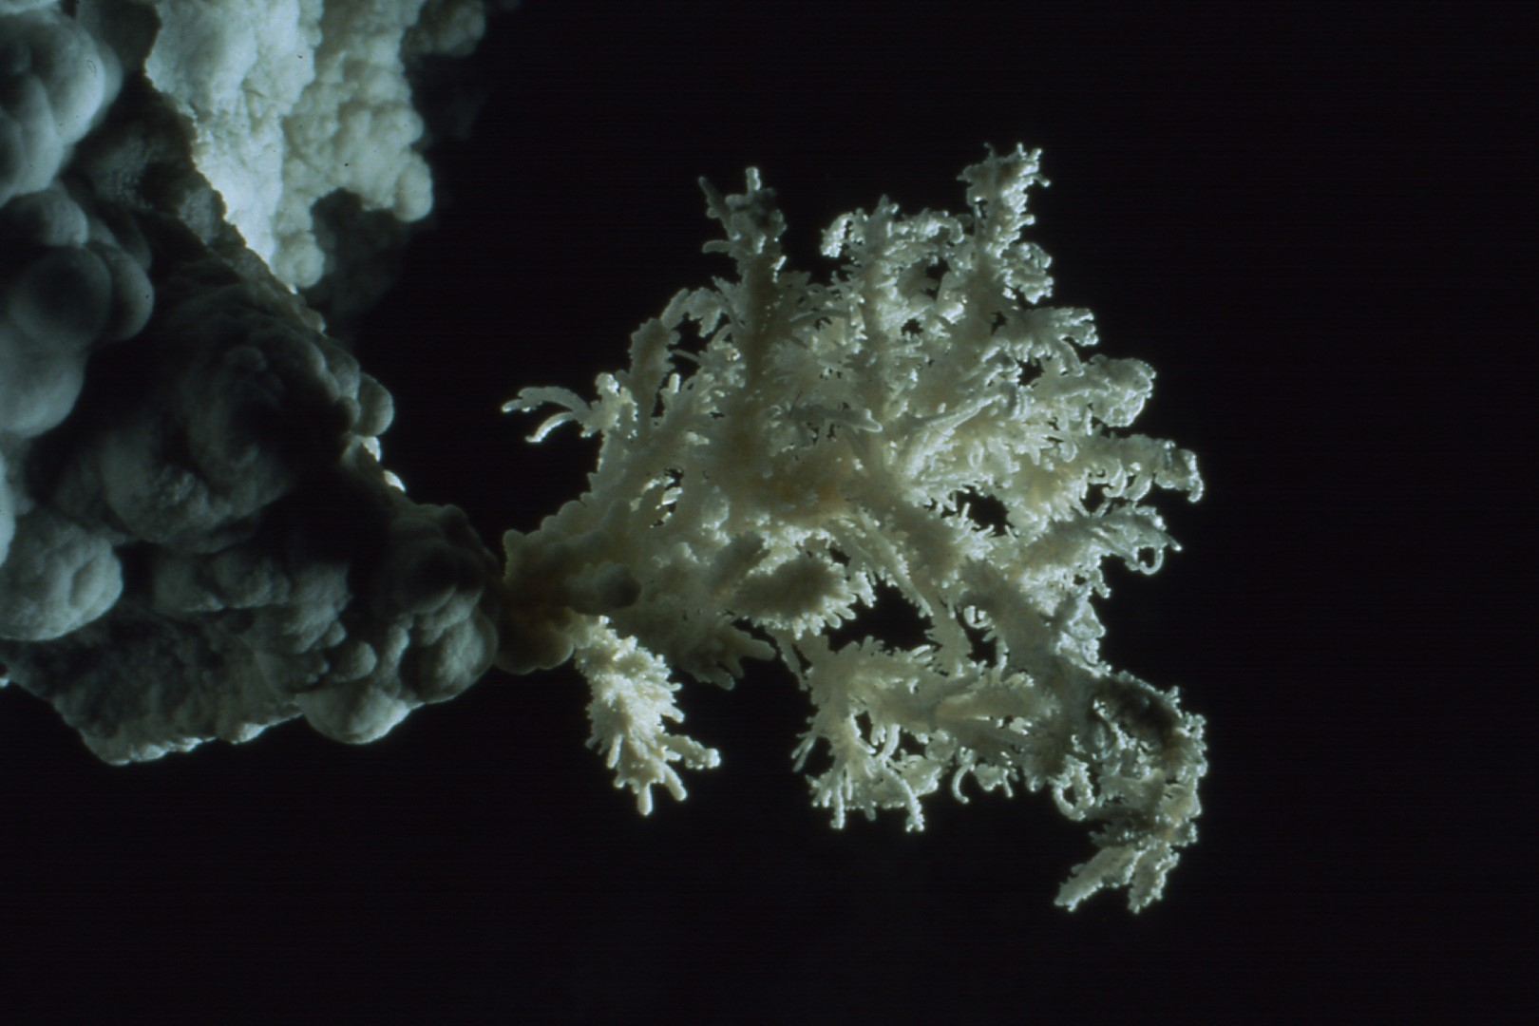
Notes:
A rare form of "feathered" aragonite in the Far East

Slide 39
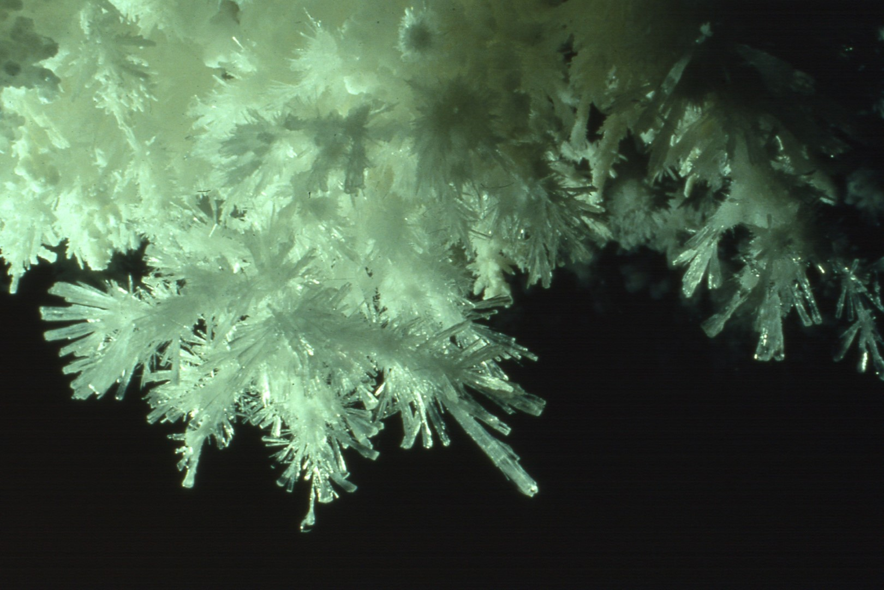
Notes:
Gypsum crystals in the Far East

Slide 40
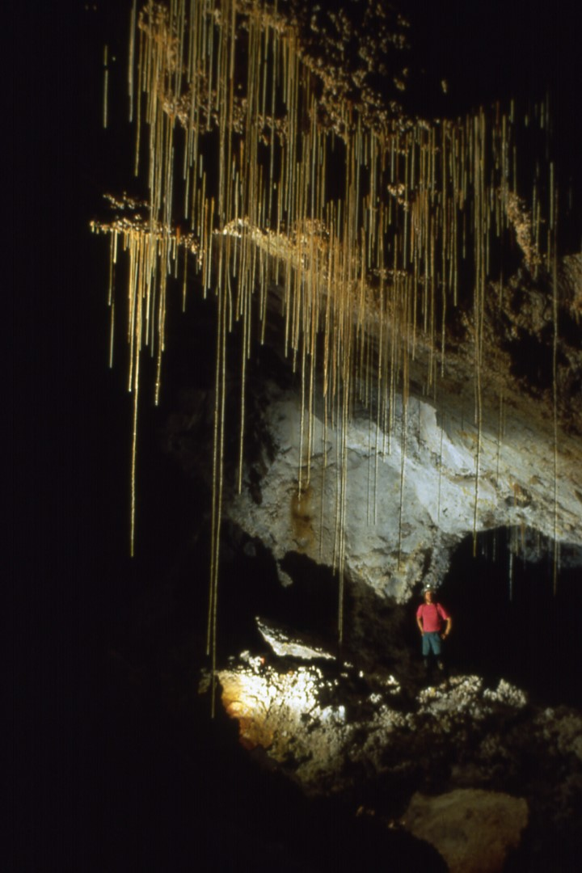
Notes:
The Swinging Soda Straw Room in the Far East

Slide 41
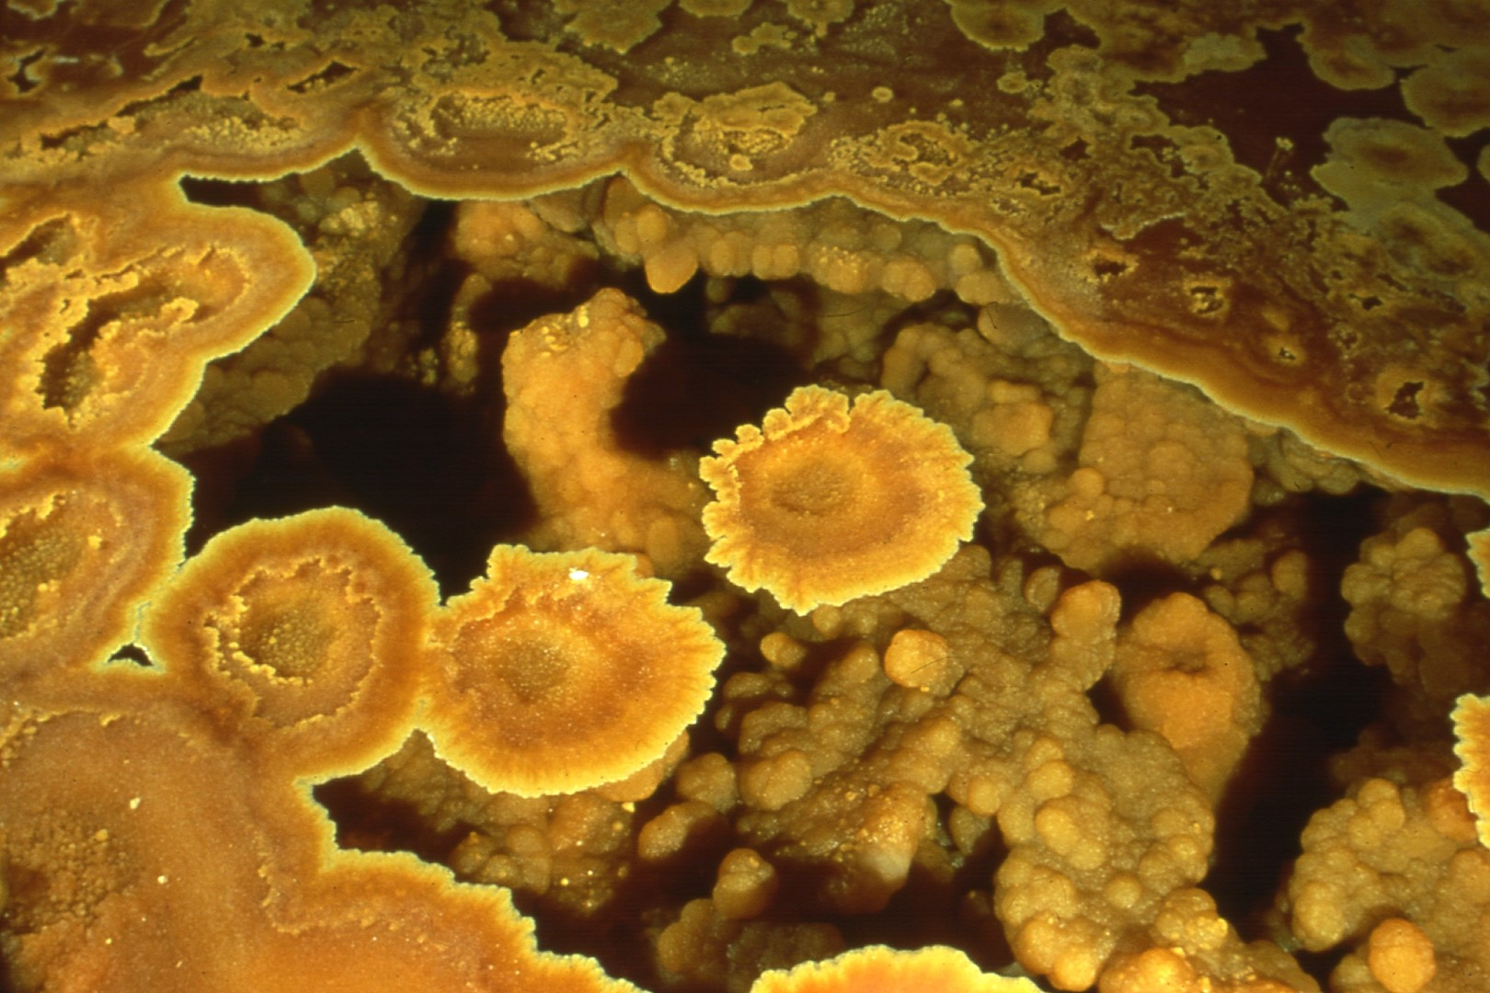
Notes:
Shelfstone on a dry pool basin in Boundary Waters, Far East

Slide 42
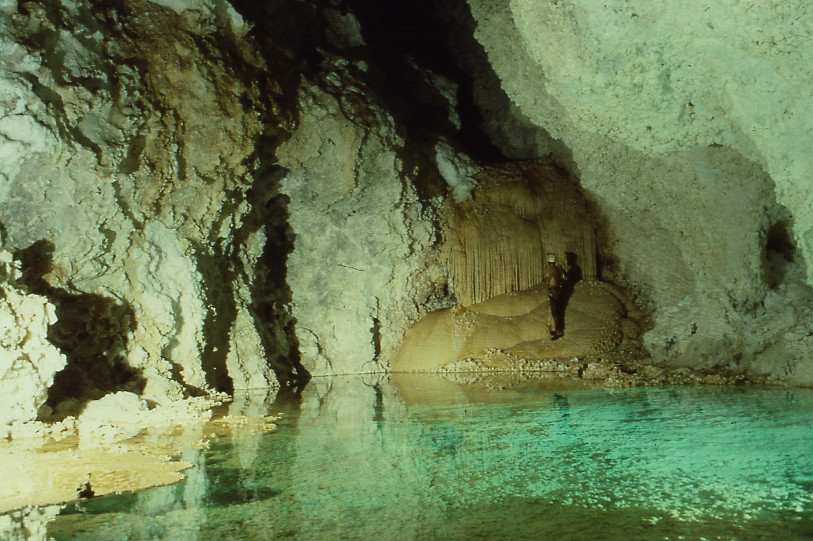
Notes:
The third and most spectacular arm of the cave, the F-survey, is reached by a series of drops ending at Lake Lebarge.

Slide 43
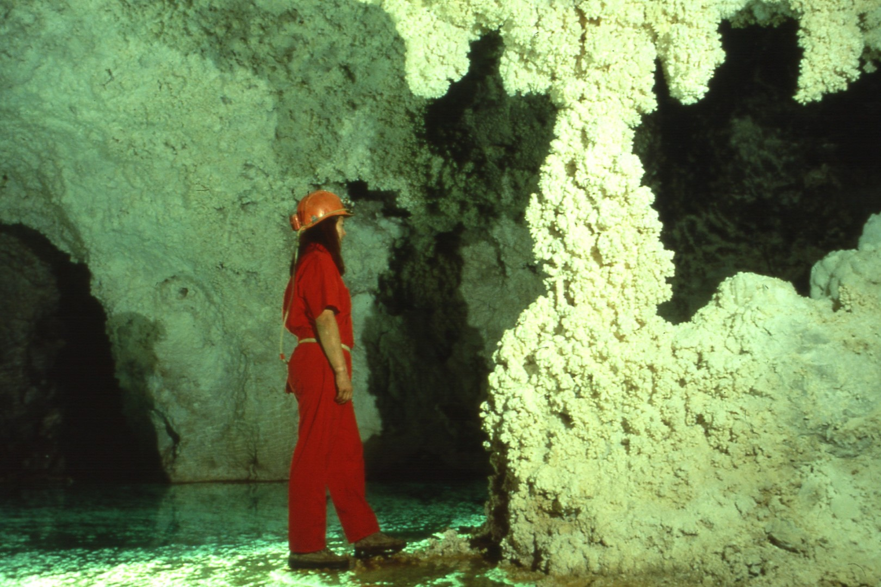
Notes:
On the far side of Lake Lebarge is this aragonite-encrusted column.

Slide 44
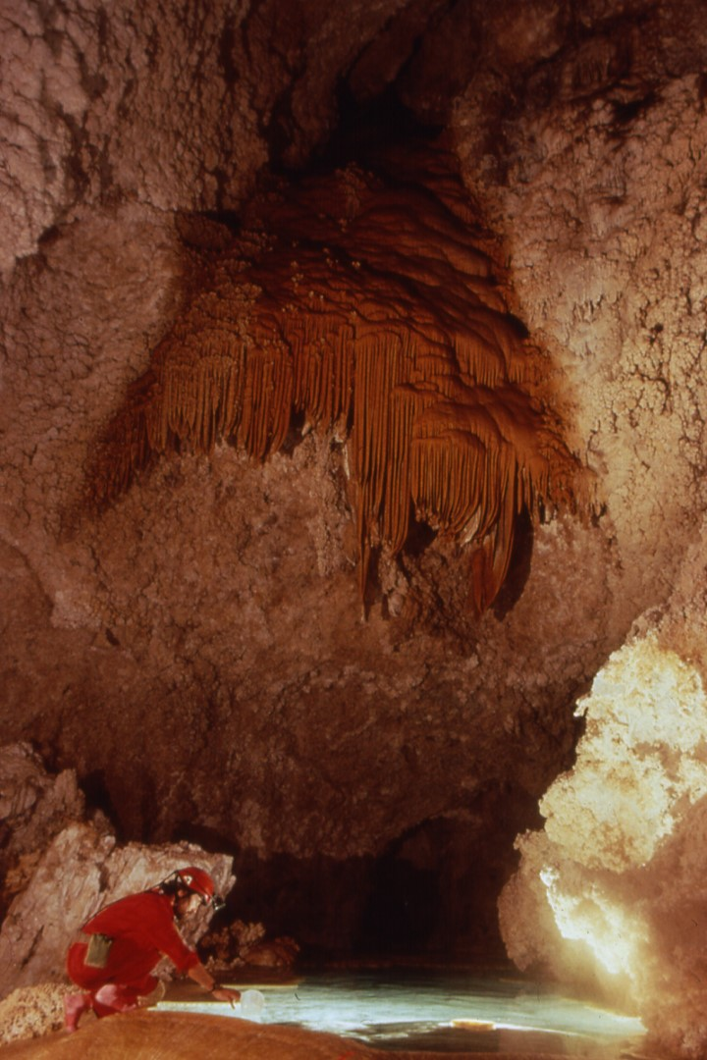
Notes:
Separated from Lake Lebarge by a huge boulder is a smaller lake Chandelar. Here a caver dips drinking water from the lake.

Slide 45
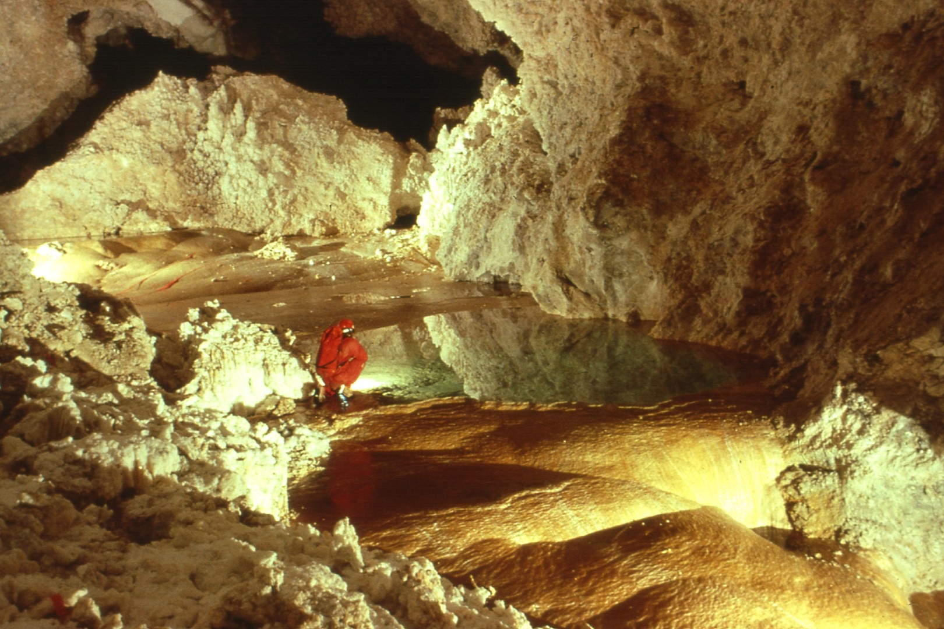
Notes:
The Yellow Brick Road is an orange flowstone cascade extending hundreds of feet.

Slide 46
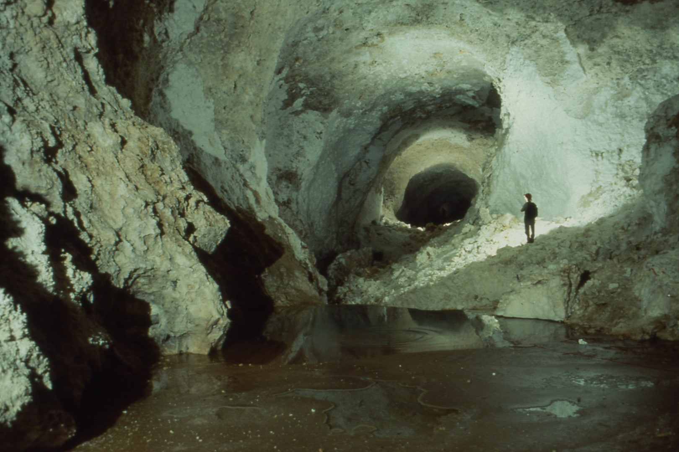
Notes:
The Lebarge Borehole is a gypsum-lined passage paralleling the Yellow Brick Road.

Slide 47
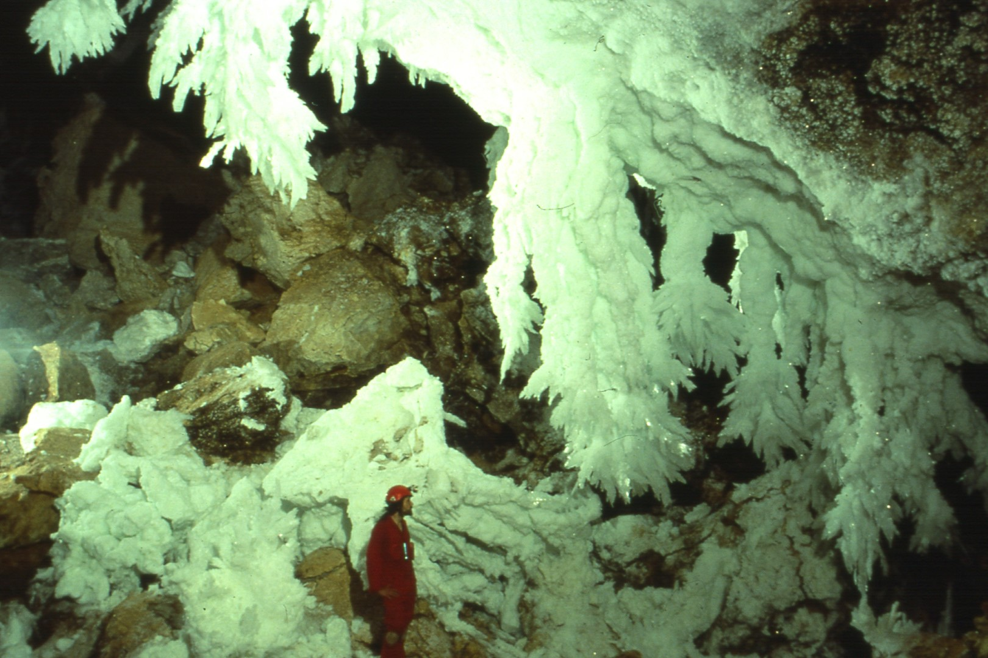
Notes:
The Chandelier Ballroom is the first large chamber beyond the Borehole. Some of the chandeliers are over 15' long, ending in selenite crystals.

Slide 48
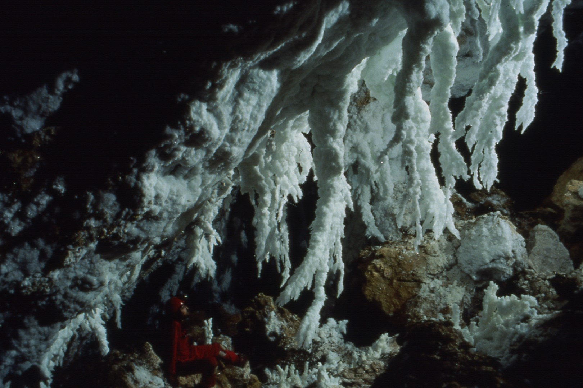
Notes:
There are several clusters of chandeliers in the room. This cluster lacks the large sprays of selenite crystals at the tip.

Slide 49
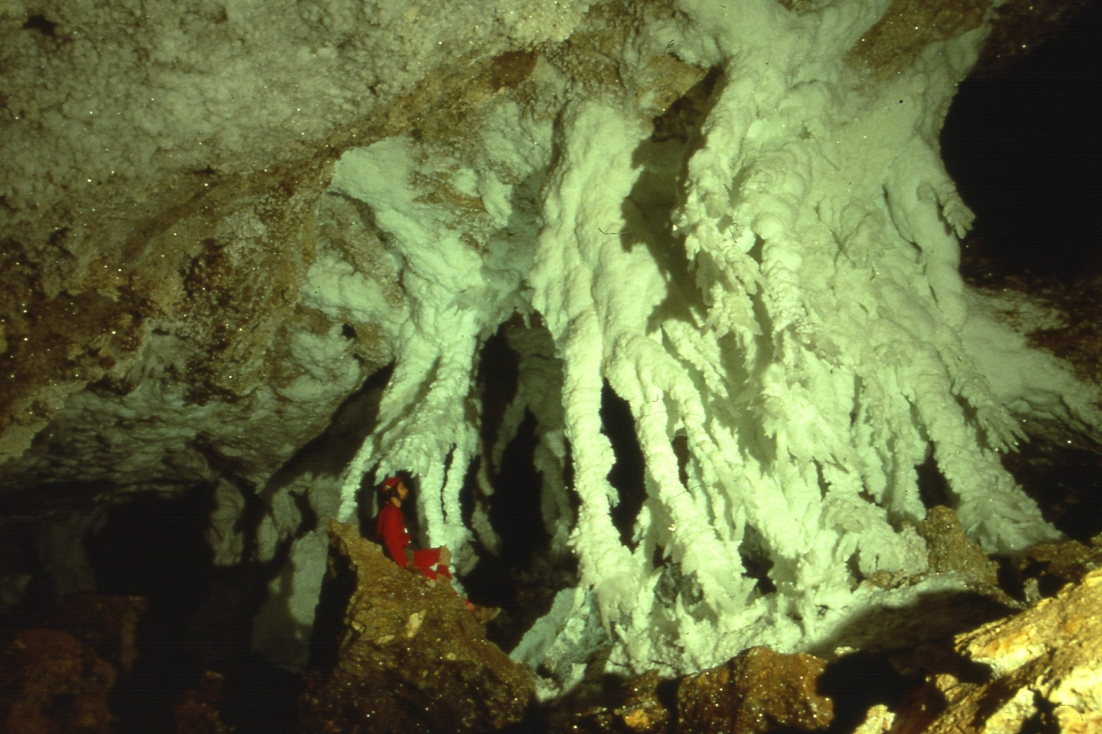
Notes:
This is another cluster of chandeliers which have formed columns.

Slide 50
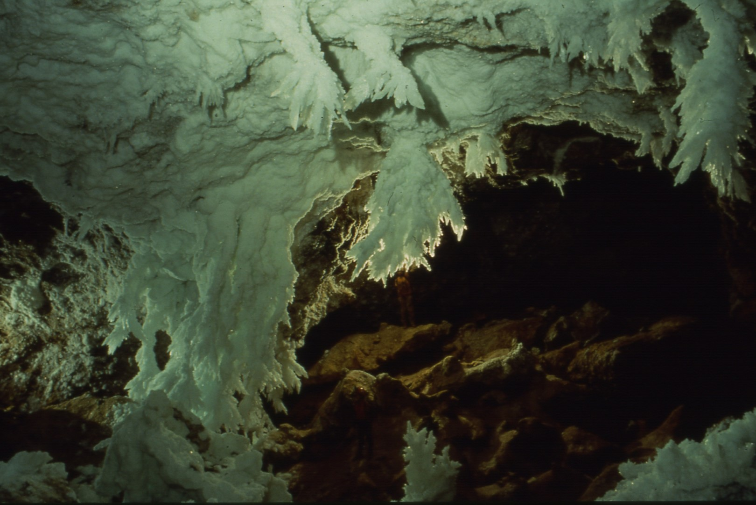
Notes:
A larger-scale view of the lower end of the Chanelier Ballroom, taken from high and to the right of the group in #47. Note the two cavers for scale.

Slide 51
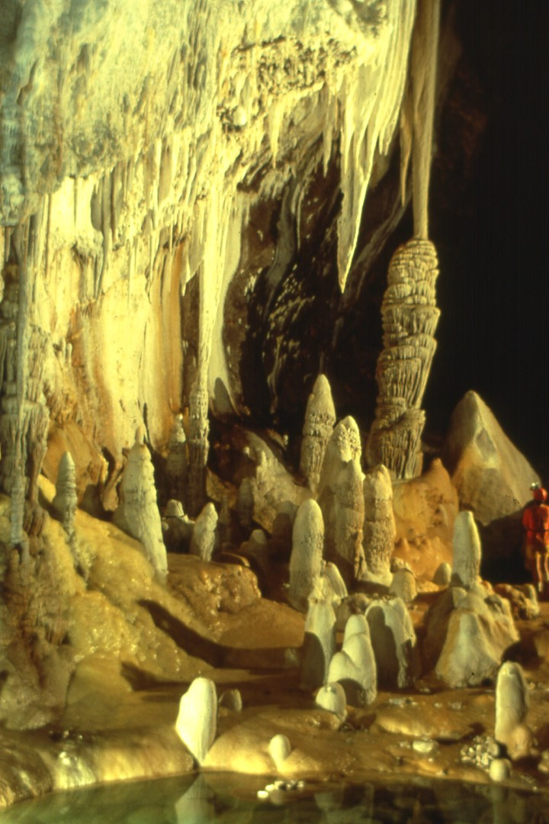
Notes:
A fifteen-minute trip from the Ballroom leads to the Pearlsian Gulf, with a blue-green lake and impressive columns.

Slide 52
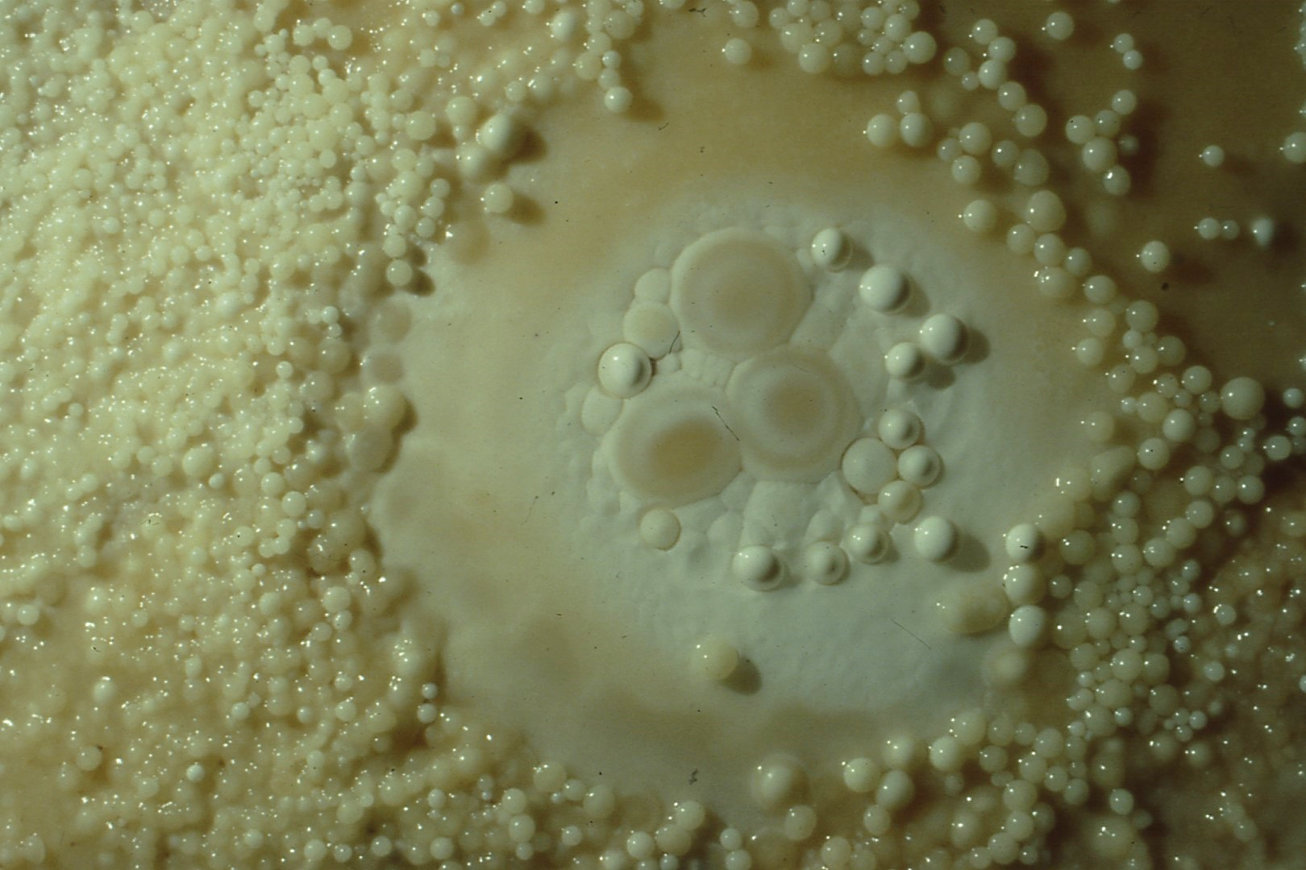
Notes:
A wide variety of pearls is found in the Pearlsian Gulf. Many are tiny, such as these.

Slide 53
Notes:
Some of the larger, "toasted" pearls have been cemented in.

Slide 54
Notes:
Some of the more unusual pearls at the Gulf look as though they have been cut from cylinders of calcite.

Slide 55
Notes:
Above the Pearlsian Gulf is a heavily decorated region known as Yo Acres.

Slide 56
Notes:
Yo Acres ascends steeply through forests of formations.

Slide 57
Notes:
Another large chamber near the Ballroom is Hoodoo Hall, named for its aragonite-encrusted raft cones. Note the caver in the middle distance.

Slide 58
Notes:
The F-survey boasts a variety of bizarre gypsum forms. These are the Dilithium Crystals, sub-aqueous selenite.

Slide 59
Notes:
This gypsum formation is fondly known as the Easter Bunny

Slide 60
Notes:
Here a gypsum rim is separating from a gypsum column.

Slide 61
Notes:
These impressive gypsum drip formations are on the slope above the Chandelier Ballroom.

Slide 62
Notes:
Between the camera and the caver is a 250' drop called Hotlanta Well, while this room is called Underground Atlanta.

Slide 63
Notes:
Above Underground Atlanta is the most impressive dripstone area in the cave, Tower Place. This is the view heading in.

Slide 64
Notes:
Large columns and stals in Tower Place.

Slide 65
Notes:
This pretty pool contains the Breast of Venus and collects the drip water in the very active Tower Place.

Slide 66
Notes:
Some of the more massive columns in Tower Place.

Slide 67
Notes:
Another view of the columns in #65.

Slide 68
Notes:
Tower place also contains some bizarrely eroded stals, such as these alien twins.

Slide 69
Notes:
Pretty patterns in an eroding stal in Tower Place. Note the drill-hole on top.

Slide 70
Notes:
Down a drop and back up another rope leads to the High Hopes area, beginning with a fine borehole in boneyard.

Slide 71
Notes:
This is perhaps the most impressive display of subaqueous helictites anywhere and is about 3’ wide.

Slide 72
Notes:
The beautiful Lake Aqua Velva lies at the foot of a long flowstone slope known as Ultra Primo.

Slide 73
Notes:
Just outside of Vesuvius is this aragonite-tipped straw we call "The Tickler".

Slide 74
Notes:
Vesuvius is a chamber named for this eruption through its flowstone floor, caused by expansion of clay.

Slide 75
Notes:
The rest of Vesuvius is a well decorated area. Access throughout is strictly "boots-off'.

Slide 76
Notes:
Beyond Vesuvius is the Jungle Room, named for its forest of soda straws, war-club stals, and fat helictites.

Slide 77
Notes:
A 1O' tall shield in the Jungle Room.

Slide 78
Notes:
We end our tour of Lechuguilla with a visit to our favorite region, Lake Castrovalva, below the Chandelier Ballroom.

Slide 79
Notes:
One must swim or raft across the 100' wide lake. On the far shore is a passage leading to a spectacular chamber.

Slide 80
Notes:
Most of this chamber is floored with ankle deep water over shelfstone, with several "cut-outs" into 1O' deep water

Slide 81
Notes:
One of the largest pieces of shelfstone anywhere on the planet is at the back of the chamber, which ends just beyond.

Slide 82
The End

